Slide 1
Notes:
It is truly an honor for me to be here in front of a group of my piers. It is also an honor to be copresenting this talk with two colleagues who I not only consider true professionals in their fields, but who I also consider close friends. We are going to spend about a half an hour talking about cold weather concrete on a project that we were all involved with near North Pole.
First let me introduce Jennifer Wilson who is the general manager for HC-Redimix in North Pole. Jennifer has XX years experience in the redimix field. She has done it all from driving the truck to running the entire operation.
Next is Simeon Brubaker, we all know him as Sim. Sim, who works for HDR, was the resident engineer on the project on behalf of the Alaska railroad. Sim’s career started in the Marine Corps and he has parlayed that into a 28 year career involved in highway and bridge construction.
I am Jason Gagnon. I was the construction manager on the project. I have worked for Kiewit Infrastructure West for 18 years. Most of my career has been focused on bridge construction. (CLICK)

Slide 2
Project Background
Notes:
I am going to start out by giving you a brief overview of the project and explain why the decision was made to have major winter concrete operations (CLICK)

Slide 3
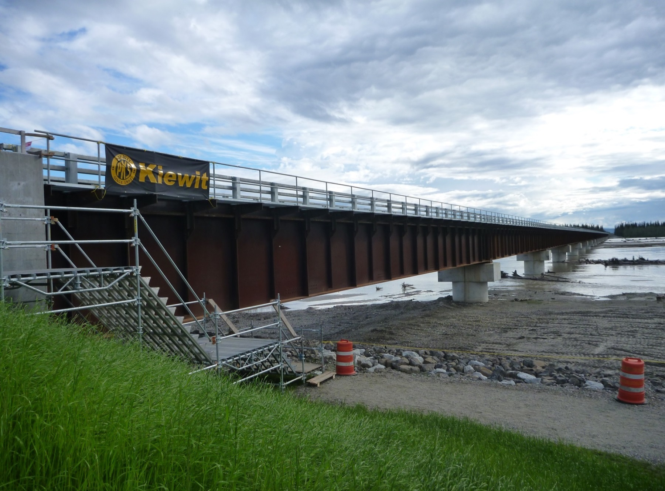
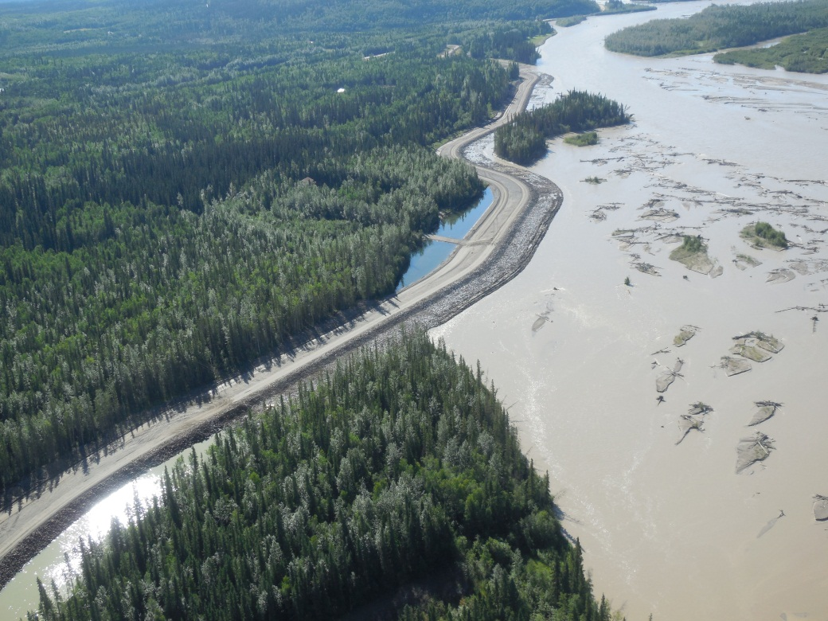
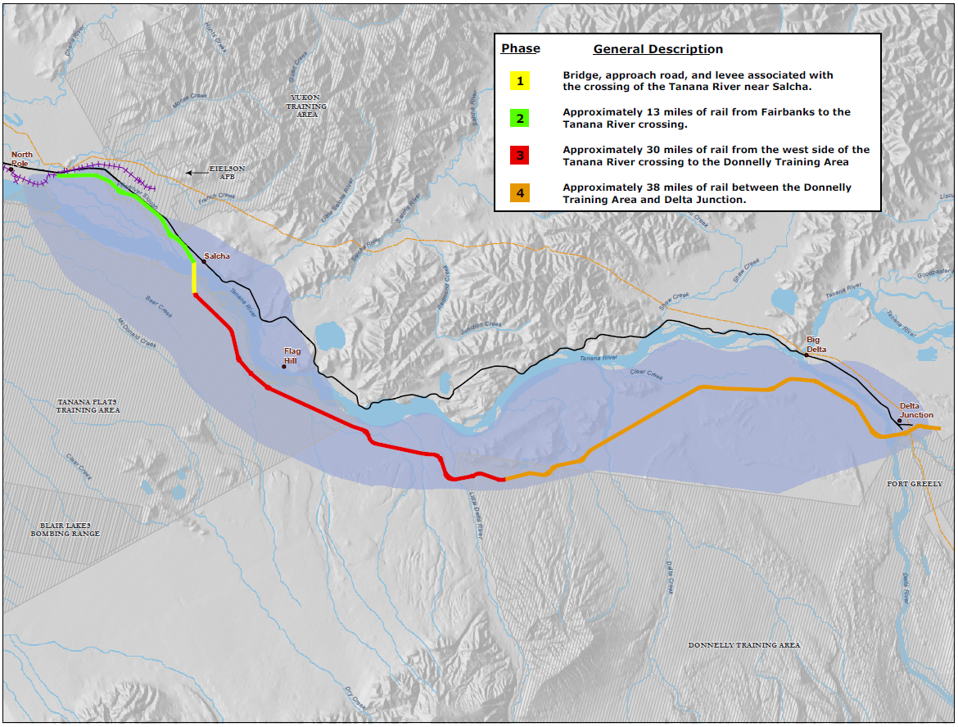
North Pole
Salcha – Phase 1 Project Site
Delta
Notes:
The project that I am talking about is the Northern Rail Extension Phase I project (CLICK)
The Client is the Alaska Railroad Corporation (CLICK)
This project is the first of four projects in the Northern Rail Extension program. The Program will ultimately connect the railhead at Eielson Airforce base to Delta Junction. The phase 1 project is the yellow line in the middle of the page.
To orient you, this is North Pole (CLICK), this is the project site in Salcha (CLICK), and this is Delta (CLICK)
There are 2 main features to phase 1, (CLICK)
First is an 11,000 ft long Rip Rap Armored Levee. (CLICK)
Second, is a 3,300 foot long, structural steel bridge across the Tanana River. This is the longest bridge in the state. (CLICK)

Slide 4
Project Used CM/GC Process
Pre-Construction Services April, 2010 through July, 2011
Permitting
Scheduling
Estimating
Construction July, 2011 through August, 2014
Worked all Operations Winter 2012
Worked limited Operations Winter 2013
Notes:
(CLICK)
This project was the first major public works to use the Construction Manager / General Contractor delivery method in the state. The railroad chose this method because it allows the contractor to be involved early in the design development phase, in a constructability role, that generally leads to cost certainty. This delivery method is different from Design Build, in that the designer works for the Client, not the Contractor.
(CLICK)
Kiewit was awarded the preconstruction services contract in April of 2010 and we worked with the railroad, HDR, and Hanson Inc, to develop the design, provide cost estimates and schedules that allowed the Railroad to make budgetary decisions. The team collaboratively applied for permits that custom suited the project. Also, there were several risk management sessions that ultimately produced a very comprehensive risk register and gave all parties a very thorough understanding of the risk on the project. The biggest benefit of this process was that we had developed a solid team and we were ready to attack the construction.
(CLICK)
The second phase was the construction phase. Work start in July 2011 and was completed this past August. Through in-depth schedule analysis it was decided that we had to work all operations (including concrete) through the Winter of 2012 and limited operations in the Winter of 2013. For anyone not familiar with winter conditions in Alaska’s interior it is –XX degrees right now and this is very common from November through March.
(CLICK)

Slide 5
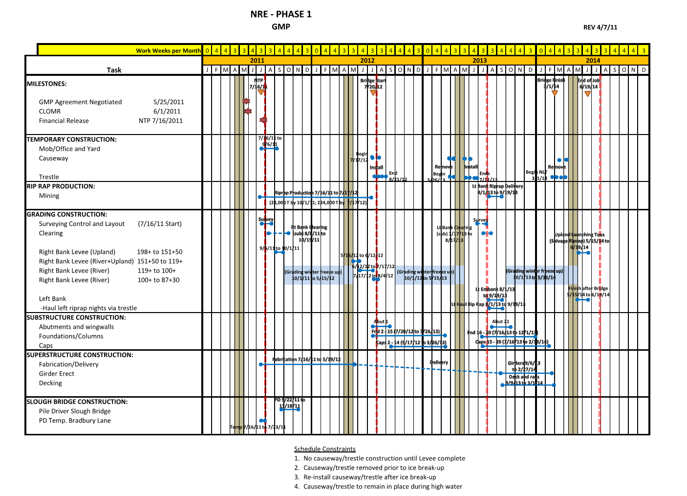
Preconstruction Summary Schedule
Project Schedule
Notes:
In April 2011, the team had jointly developed a construction schedule that is summarized here. I know it is hard to read but I will blow up some important areas.
To understand why we chose to work through the winter it is important to understand some constraints that we had in the schedule. (CLICK)
We had several thousand feet of trestle and causeway, for temporary access, that was not designed to withstand the break up of the Tanana River. (CLICK)
So we determined that every spring we had to remove and replace our access. (CLICK)
The trade off for this forced us to work through the winter. (CLICK)
So you can see we had to schedule footings, columns and caps to work through the winter. (CLICK)

Slide 6
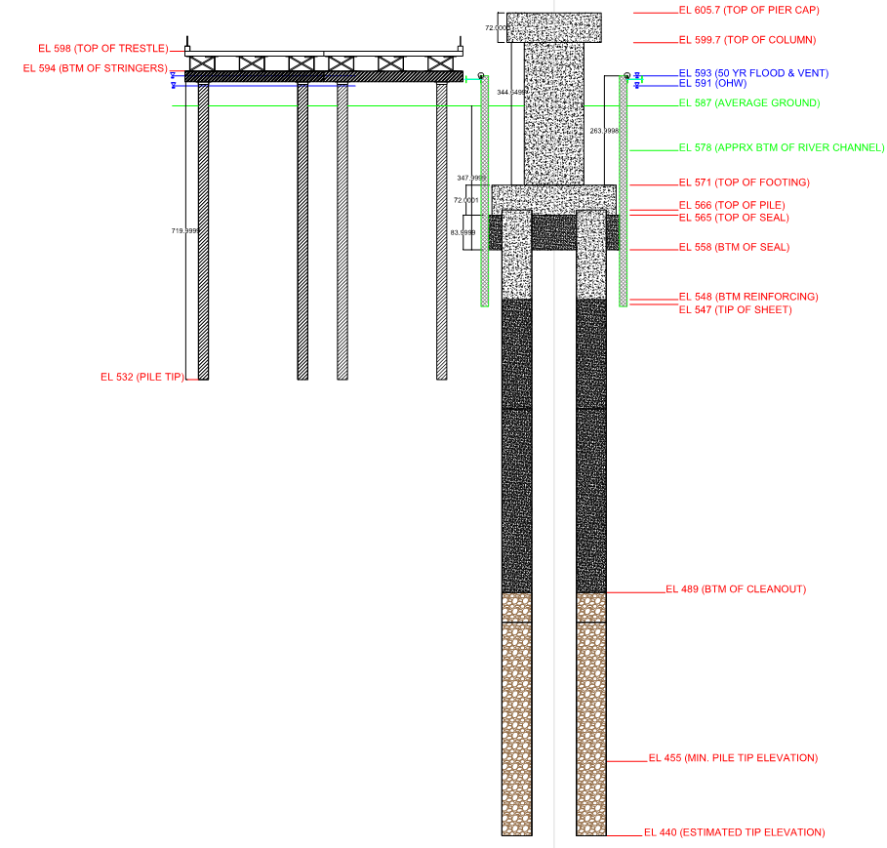
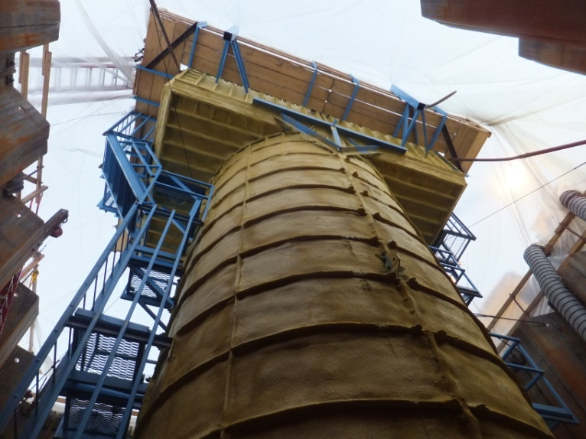
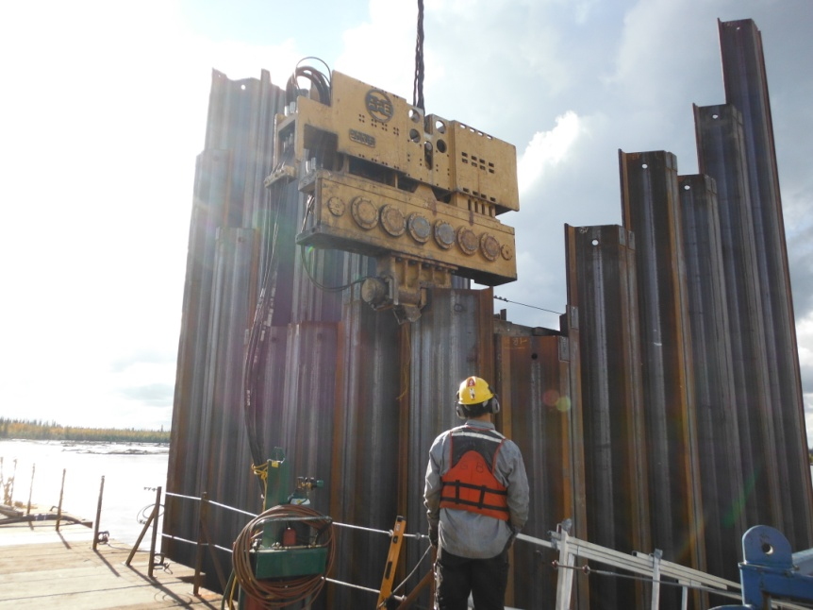
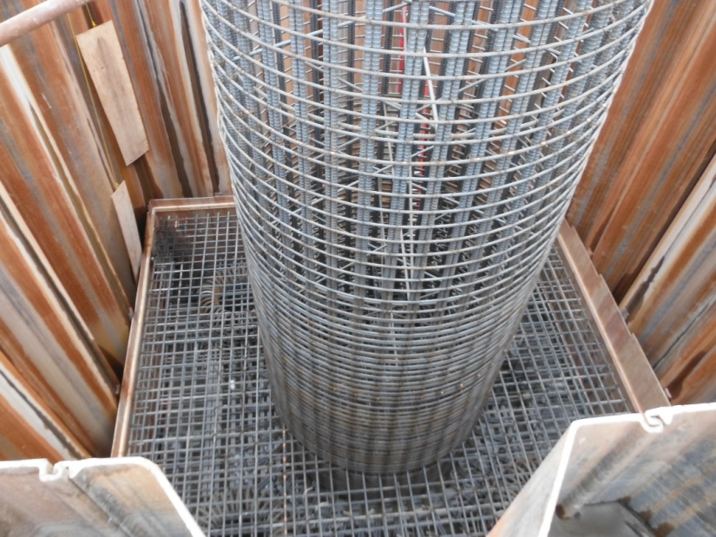
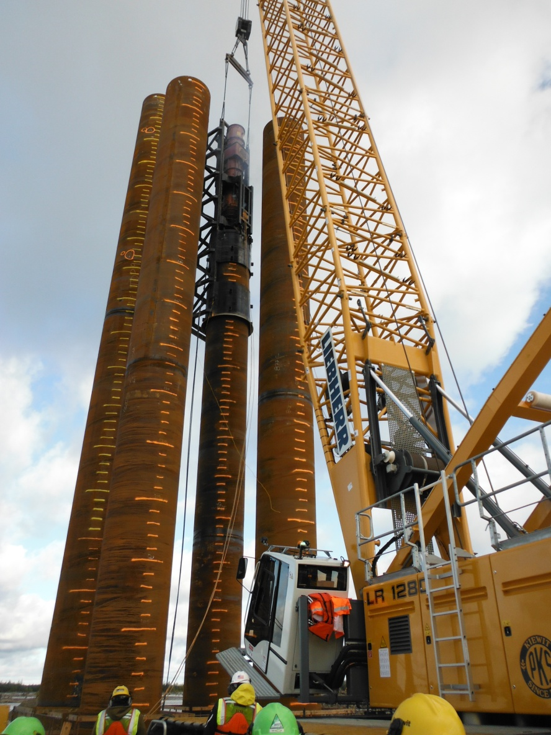
Notes:
I want to give you a brief description of the work. Well start with the bridge substructure. This is a cross section of a typical pier with our trestle access. There are 19 in rivers piers. This is where the majority of the concrete is on the project. (CLICK)
Each pier had a cofferdam and seal was poured. (CLICK)
Here is a picture of a cofferdam being installed (CLICK)
Next there 76 pile, four at each pier (CLICK),
Here is the pile driving spread at work (CLICK)
Each pier had a 25x25x6 footing, (CLICK)
a 12’ diameter column that was 29 feet tall (CLICK)
and a 19x12x6’ Pier cap. (CLICK)
This footing is ready for a pour (CLICK)
Here is a picture of our column / cap formwork (CLICK)

Slide 7
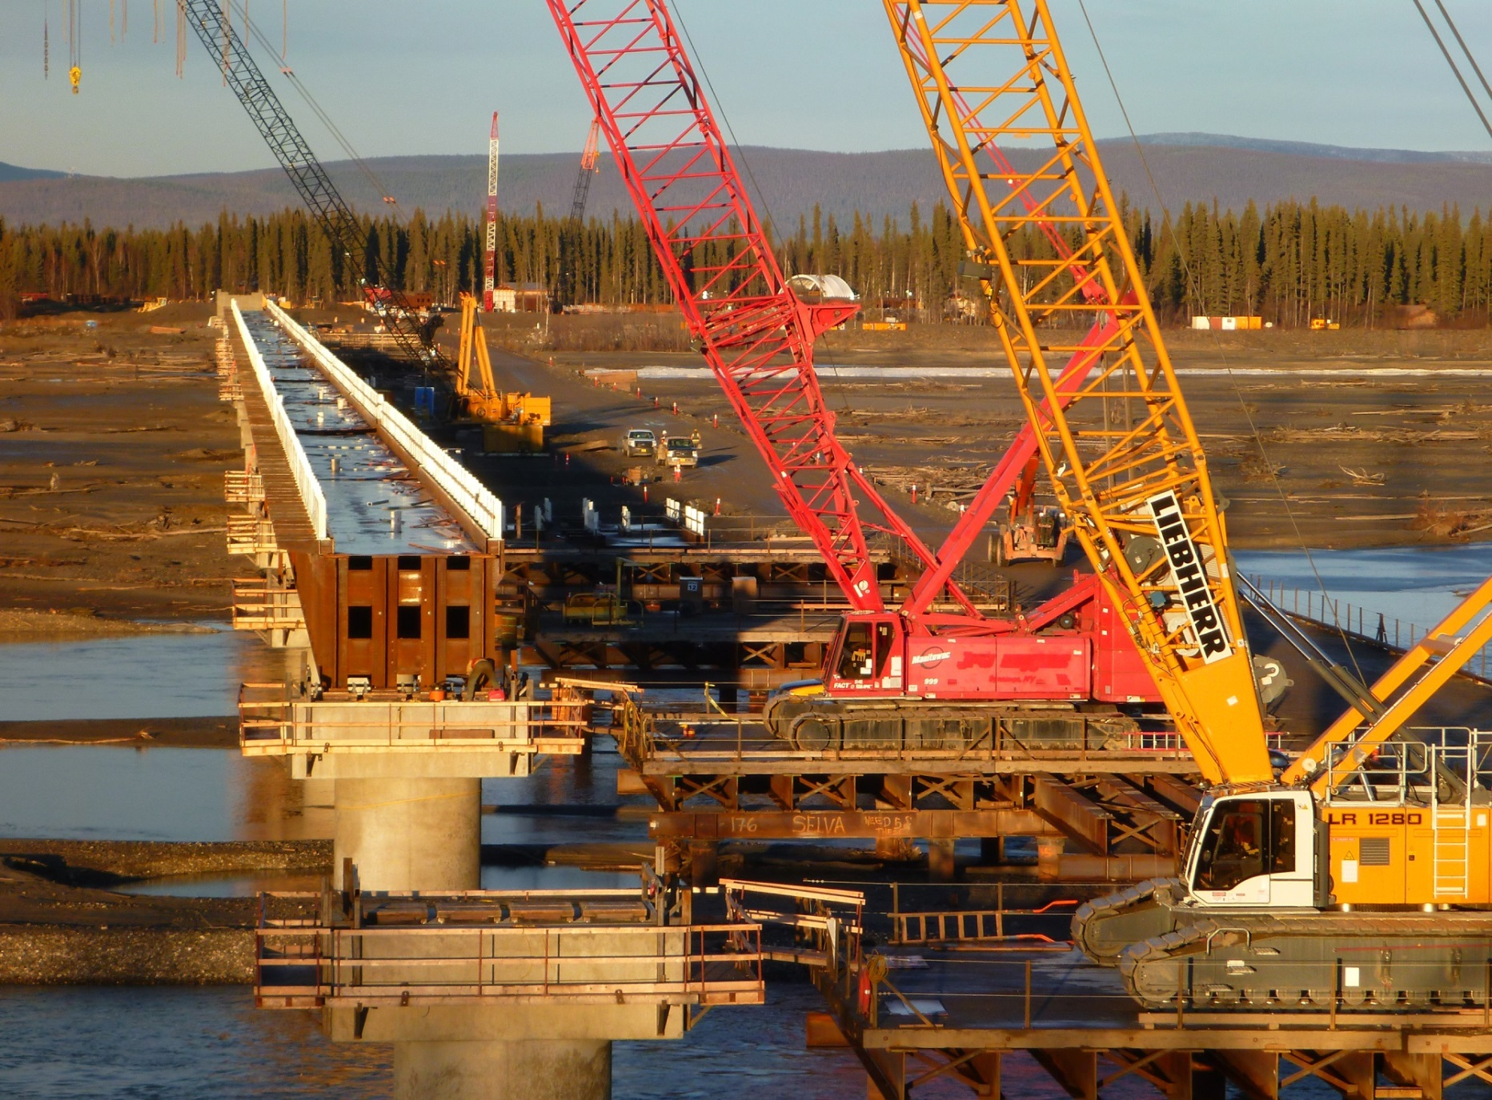
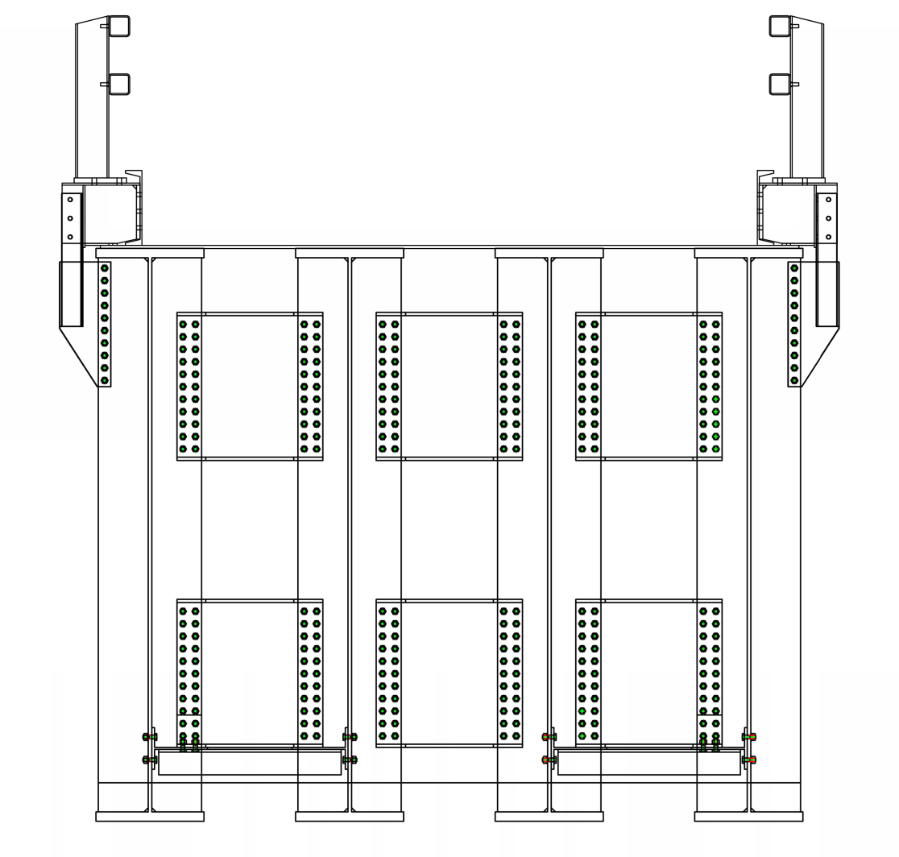
Deck Pans
Diaphragms
Girders
Notes:
Here is the full cross-section of the superstructure (CLICK)
The Superstructure consisted of 20 spans of girders with 4 girders in each span. (CLICK)
There were two levels of diaphrams (CLICK)
And a steel pan for the deck (CLICK)
This picture was taken during girder erection (CLICK)

Slide 8
Why Winter Concrete?
Schedule
Temporary River Access
Cost vs Benefit
Expiring Funding
Notes:
Some of you may still be asking why winter concrete in Fairbanks.
We have talked about the schedule ramifications that had we not worked through the winter it would have added a season to the project.
This would have meant that we would have had to remove and reinstall our in river access a third time. This had major direct cost implications in addition to all the added escalation and overhead that would have gone with extending the project duration by a year.
Ultimately the cost and risk of an added season was weighed against winter concrete. What ultimately tipped the scale was that the railroad’s funding had sunset or expiration clauses attached to them. So, we as a team, decided that the best route was to plan for and deal with winter concrete and take a season off of the job. (CLICK)

Slide 9
Supplier’s Perspective

Slide 10
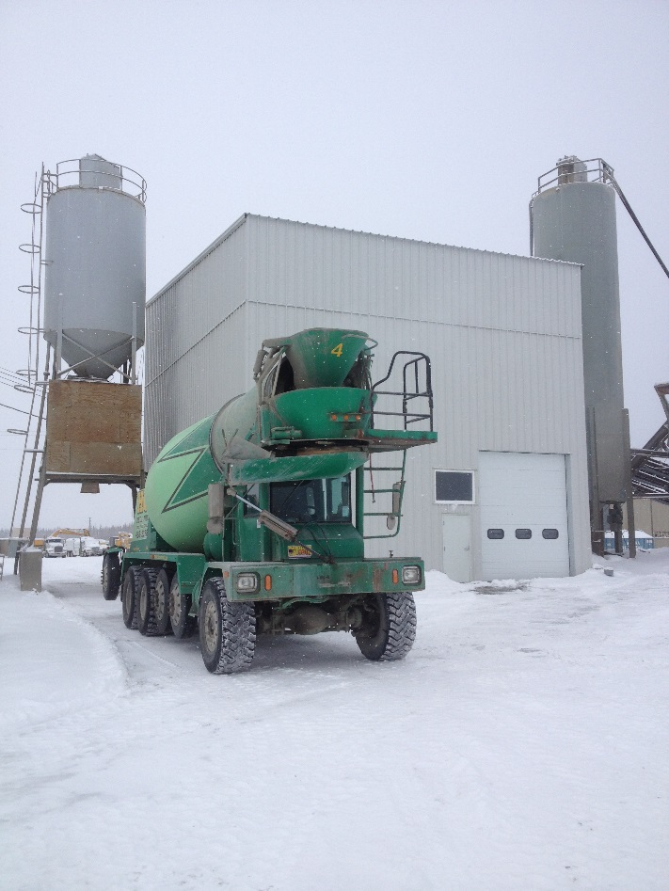
Issues Related to Production,
Delivery & Placement
Weather
Logistics
Darkness

Slide 11
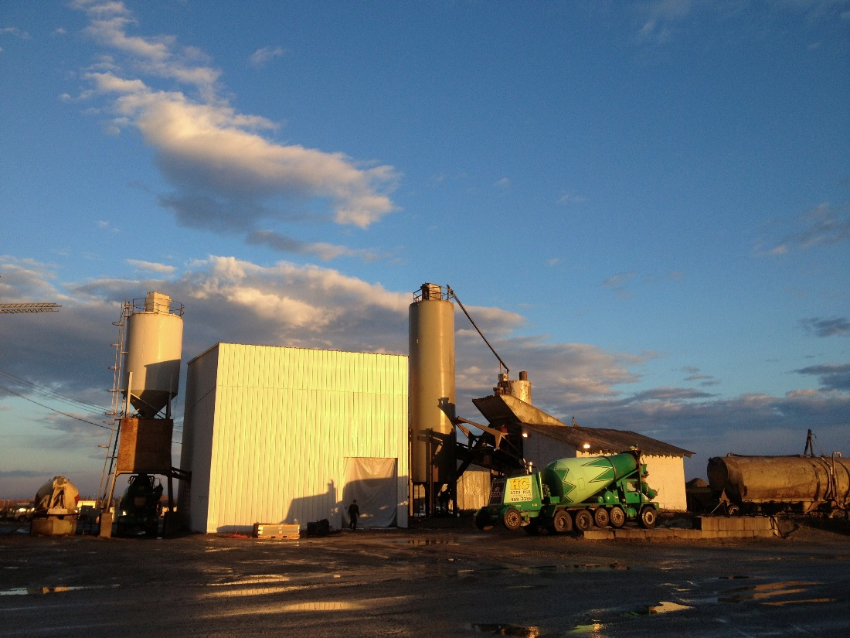
It all started on Sept 12, 2012
It was a mild autumn day and the batching and delivery went off without a hitch. That would soon change…

Slide 12
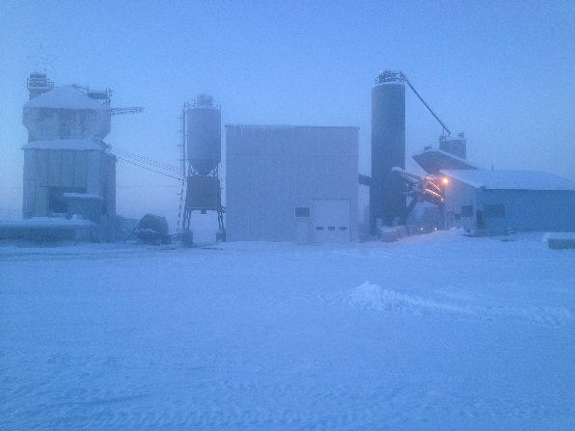
How Cold is Too Cold?
ACI 306 – “3 successive days the average daily outdoor temperature drops below 40˚F”
HC Redi-Mix – Lower limit for batching is -5˚F.

Slide 13
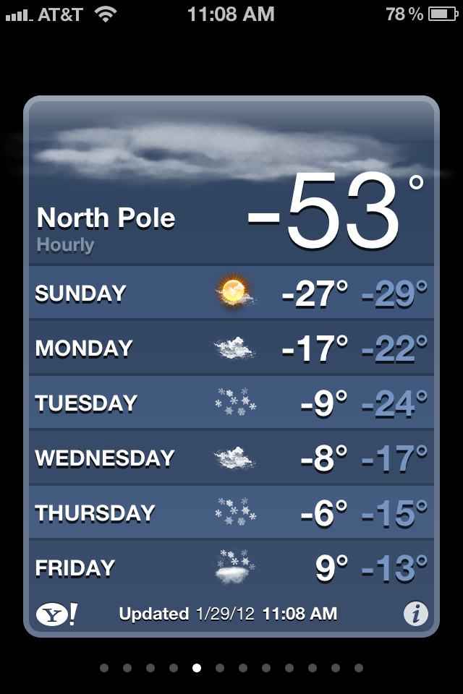
This led to many days of staring at the thermometer, and willing the temperature to go up.

Slide 14
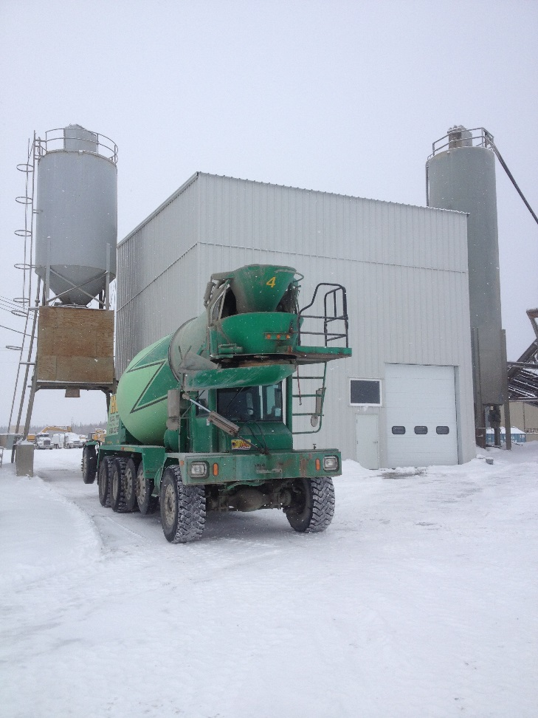
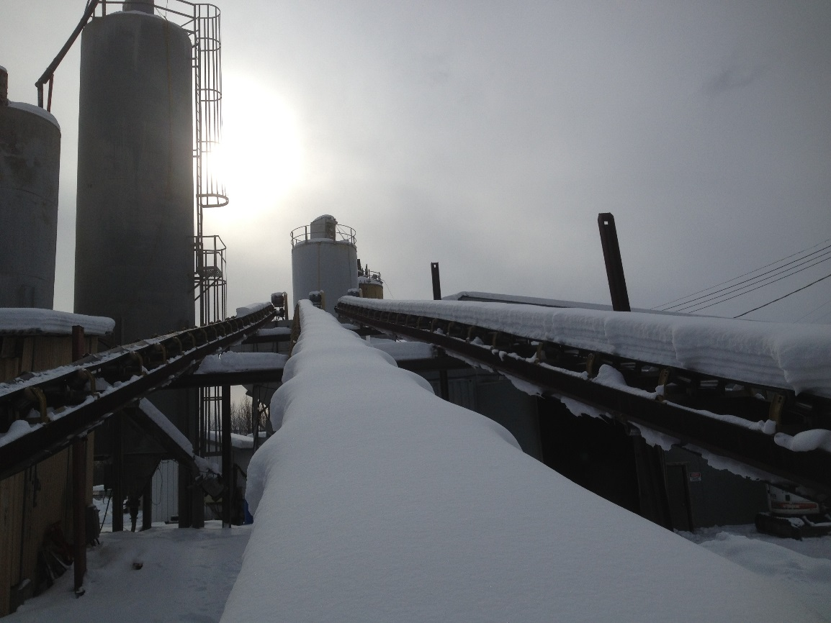
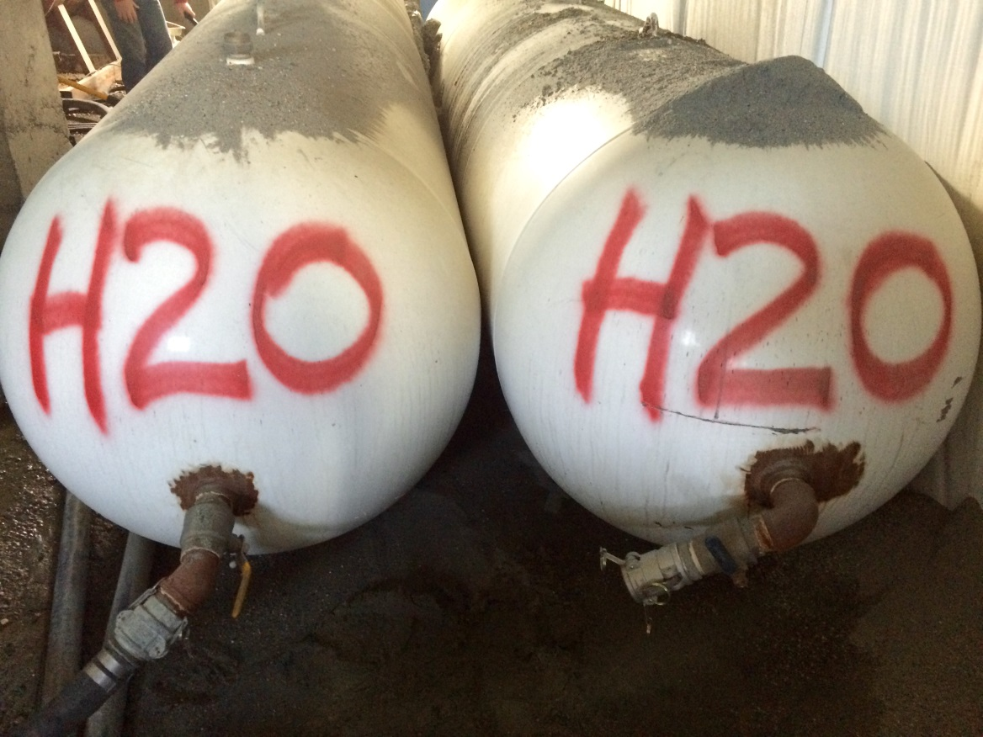
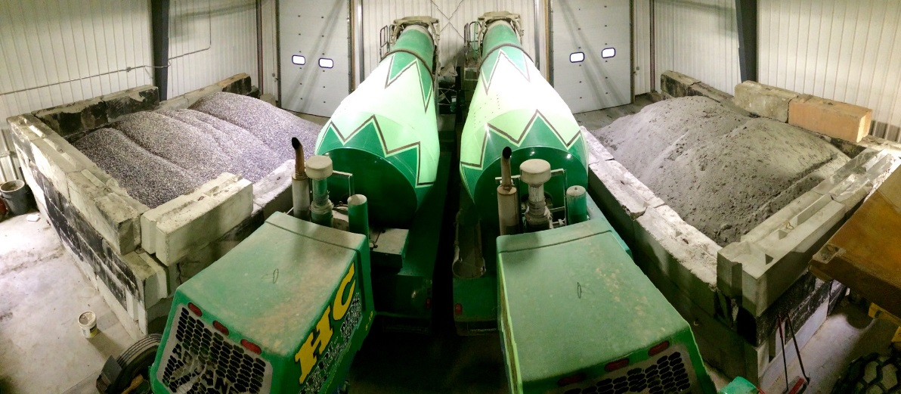
Batching
Frozen/ice glazed conveyor belts and bins
Frozen air lines on the plant
Frozen aggregate
Cold water

Slide 15
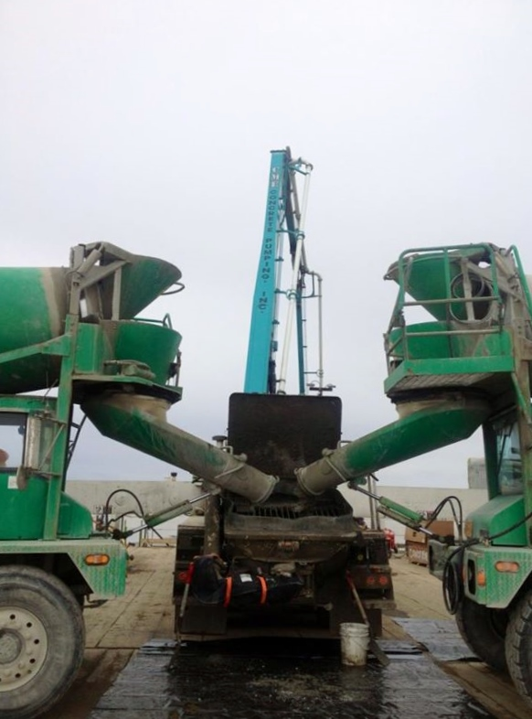
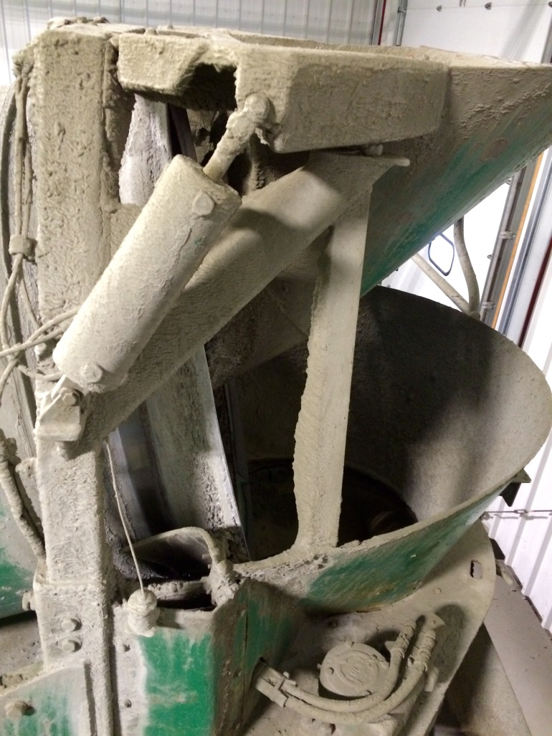
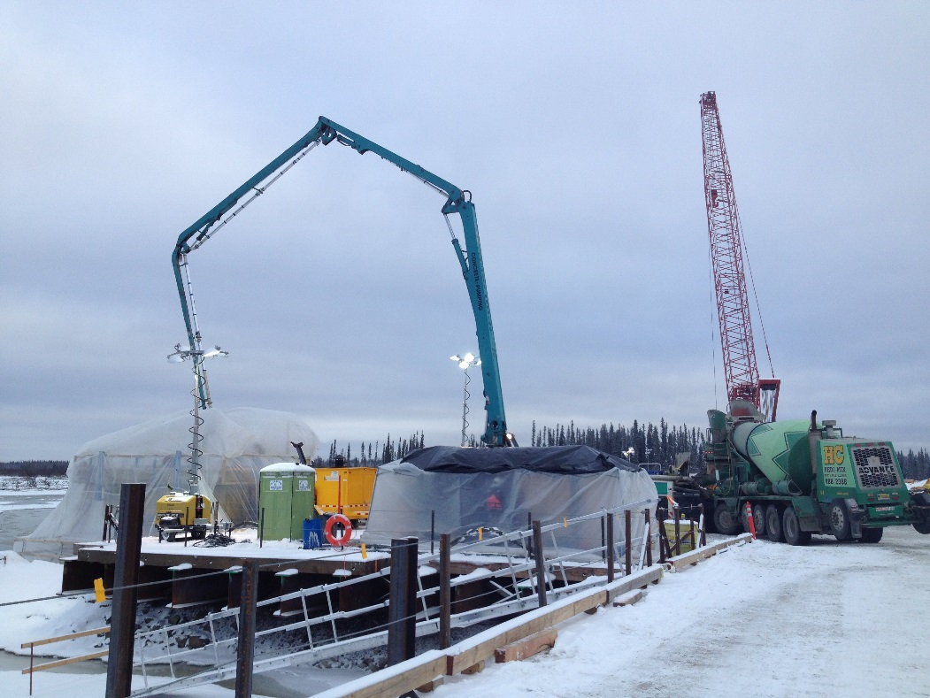
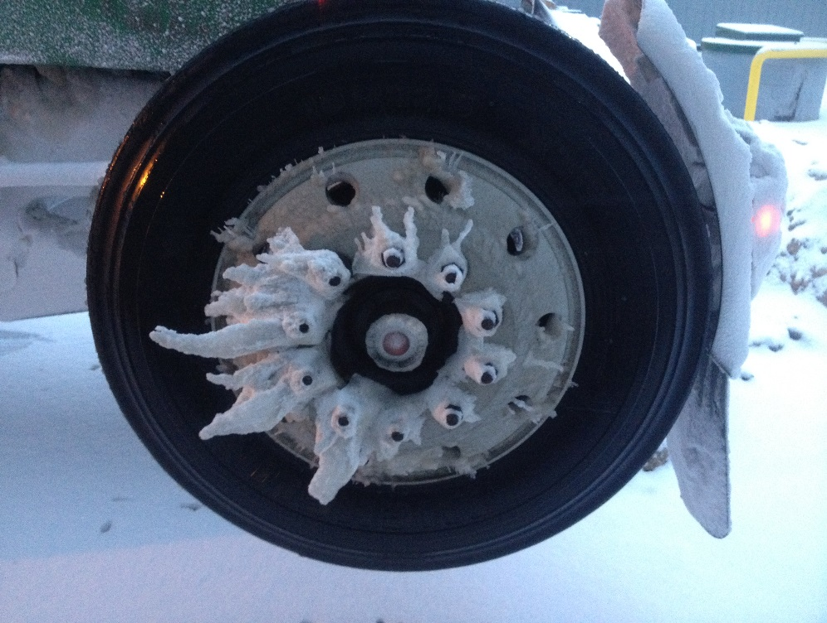
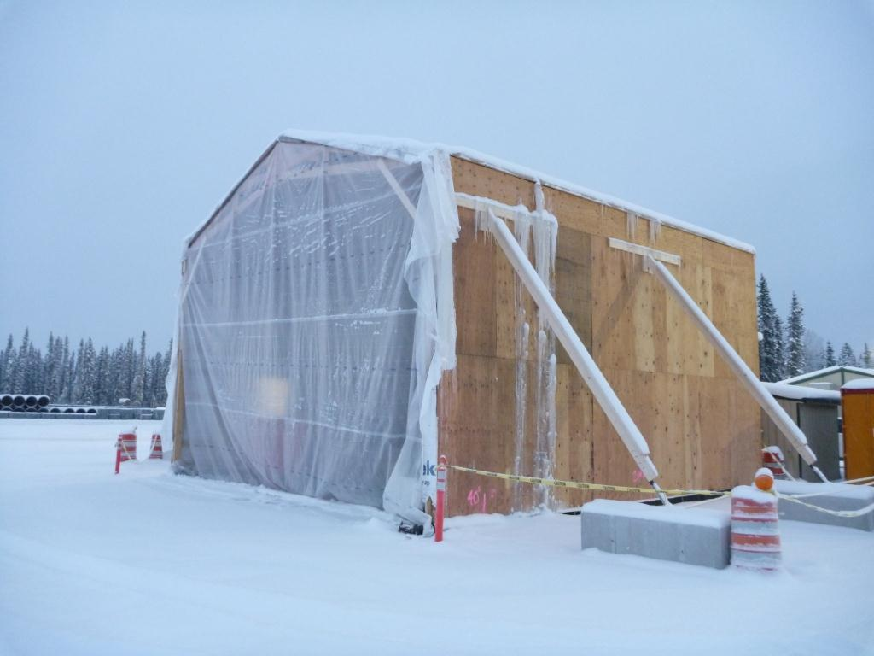
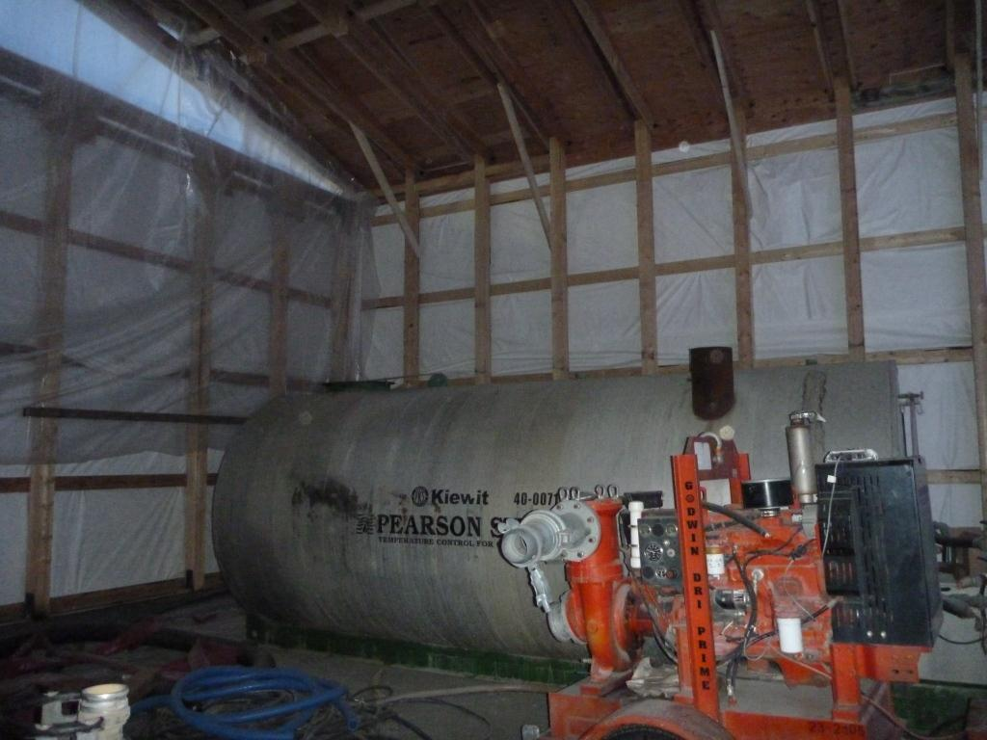
Delivery
Trucks wouldn’t start
Frozen water valves
Concrete frozen in chutes
Concrete T˚ too low

Slide 16
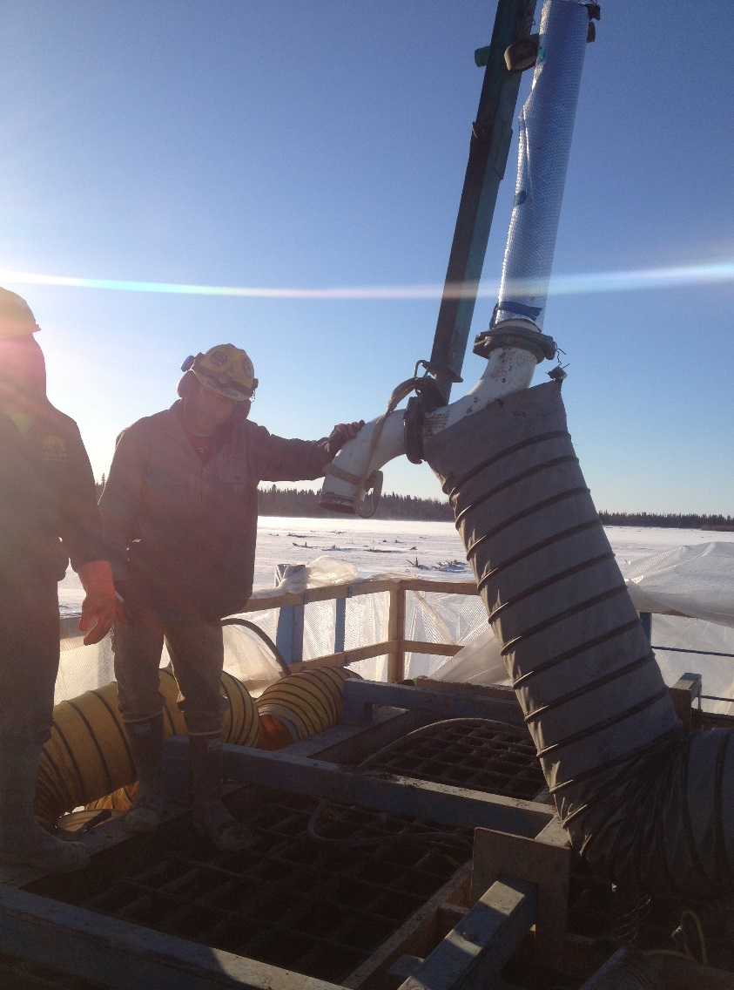
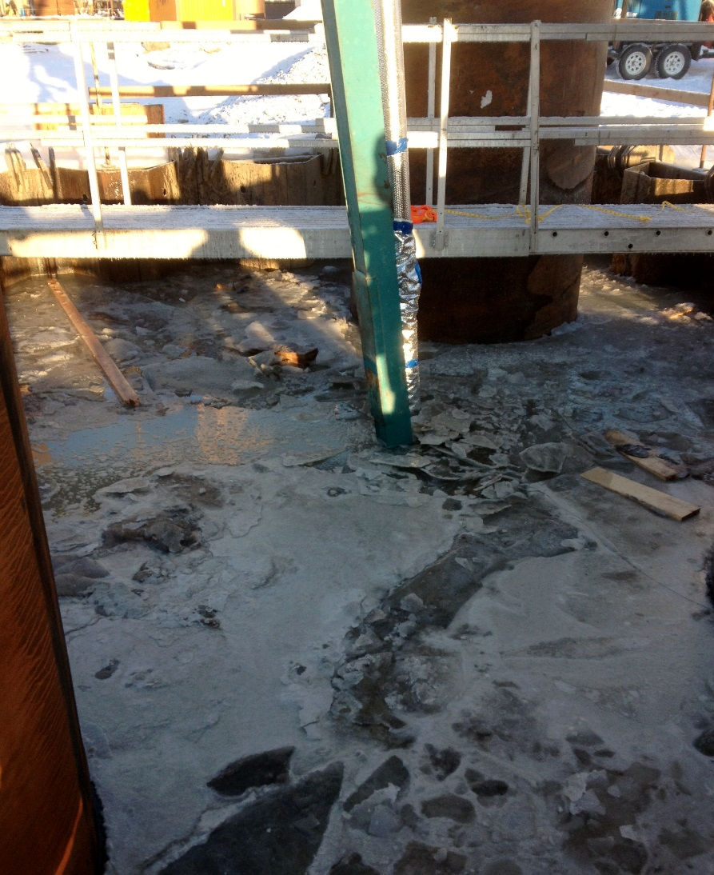
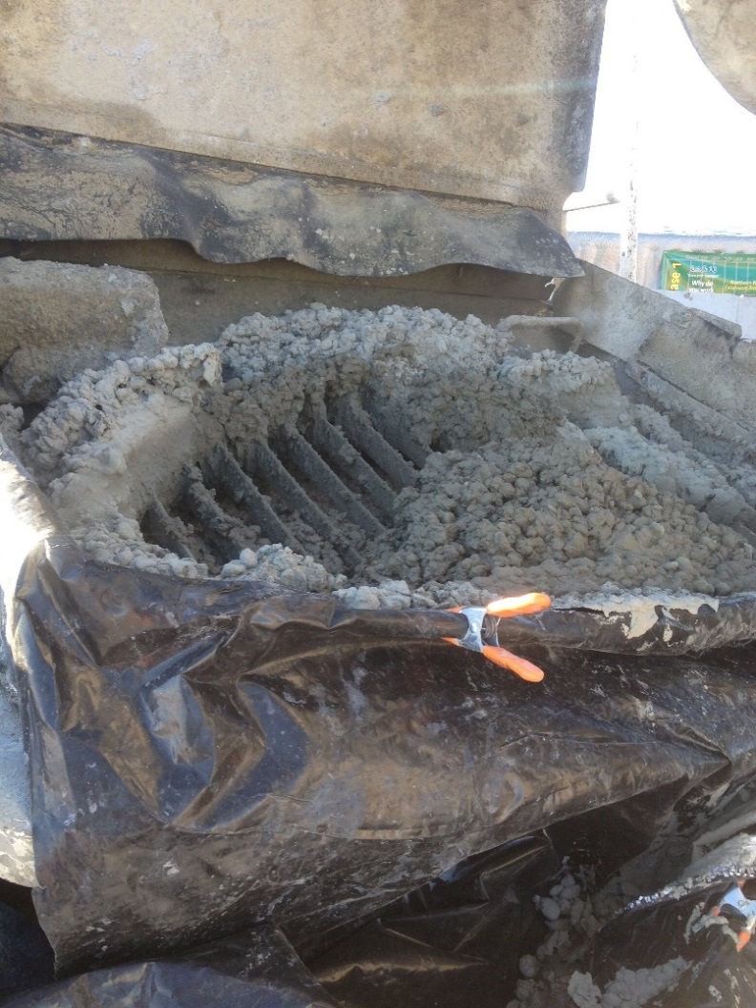
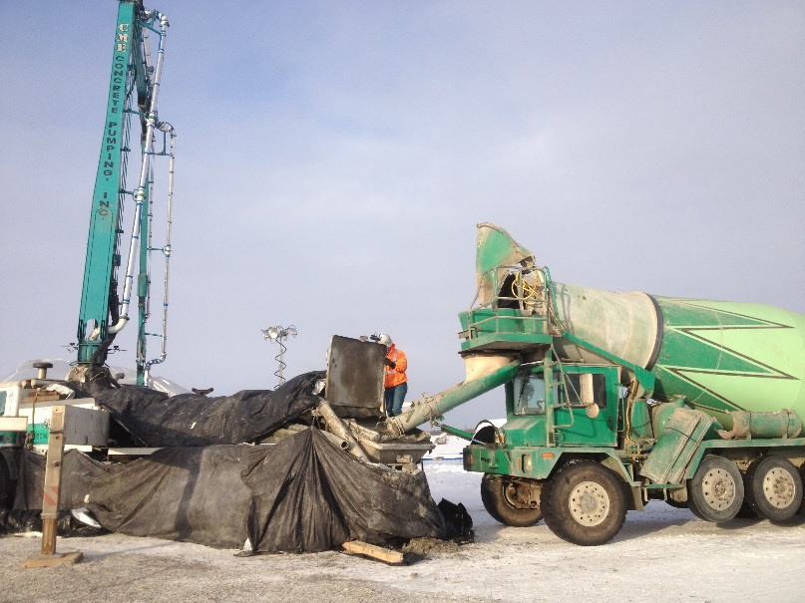
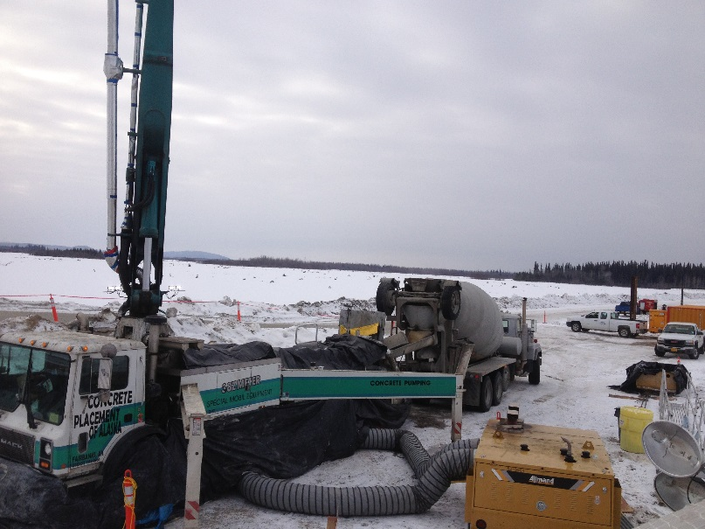
Placement
The pump got too cold
Concrete froze on the hopper grate
Concrete froze in the pipes

Slide 17
Occasional high winds made
placement challenging

Slide 18
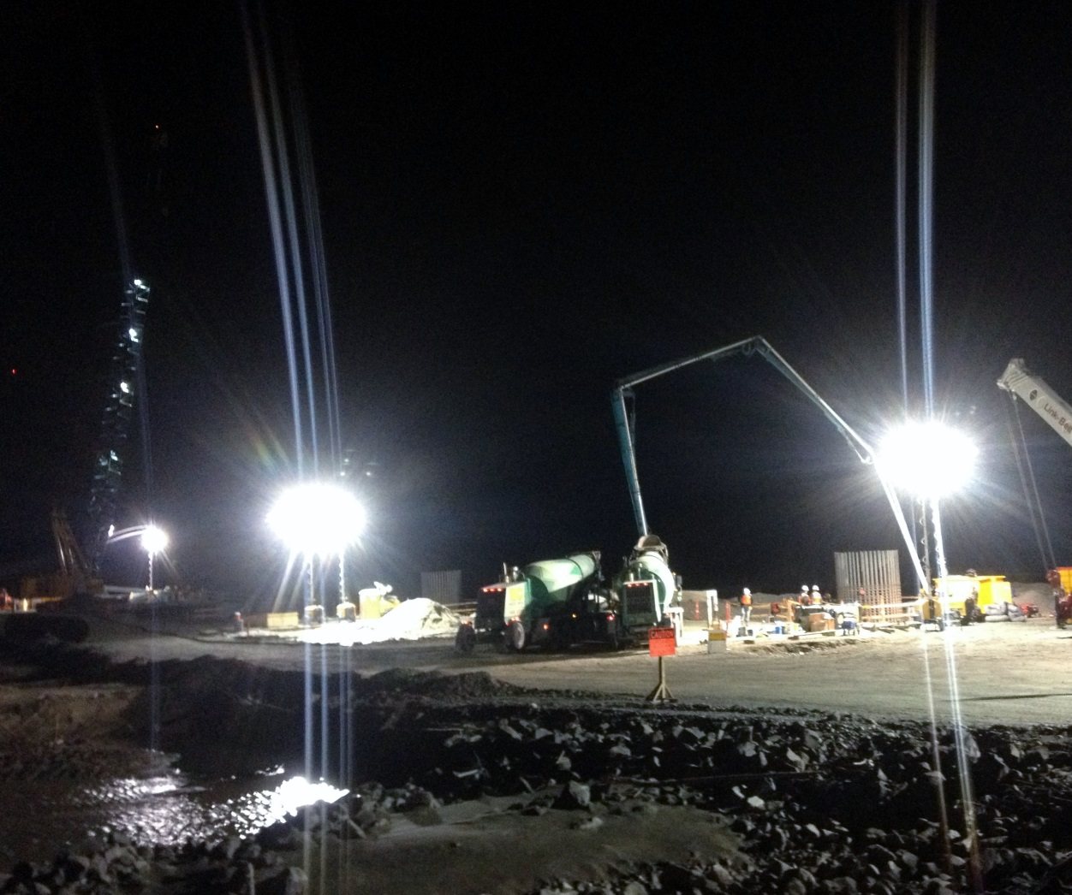
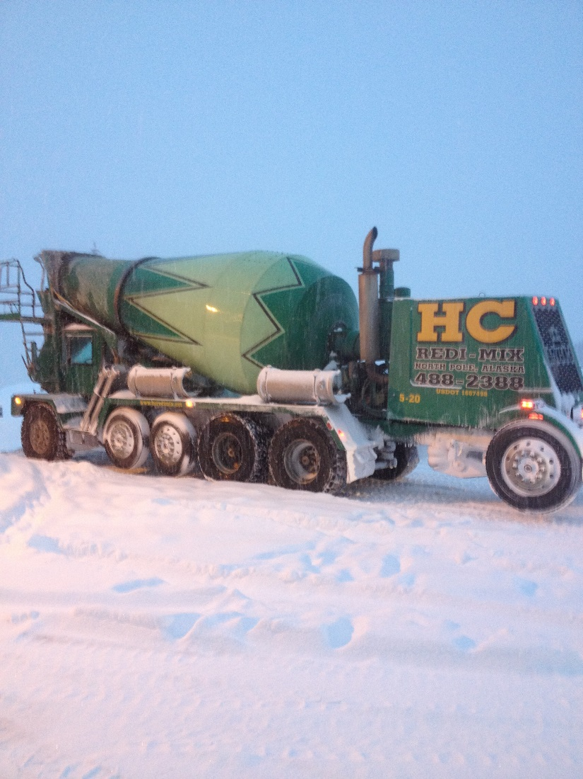
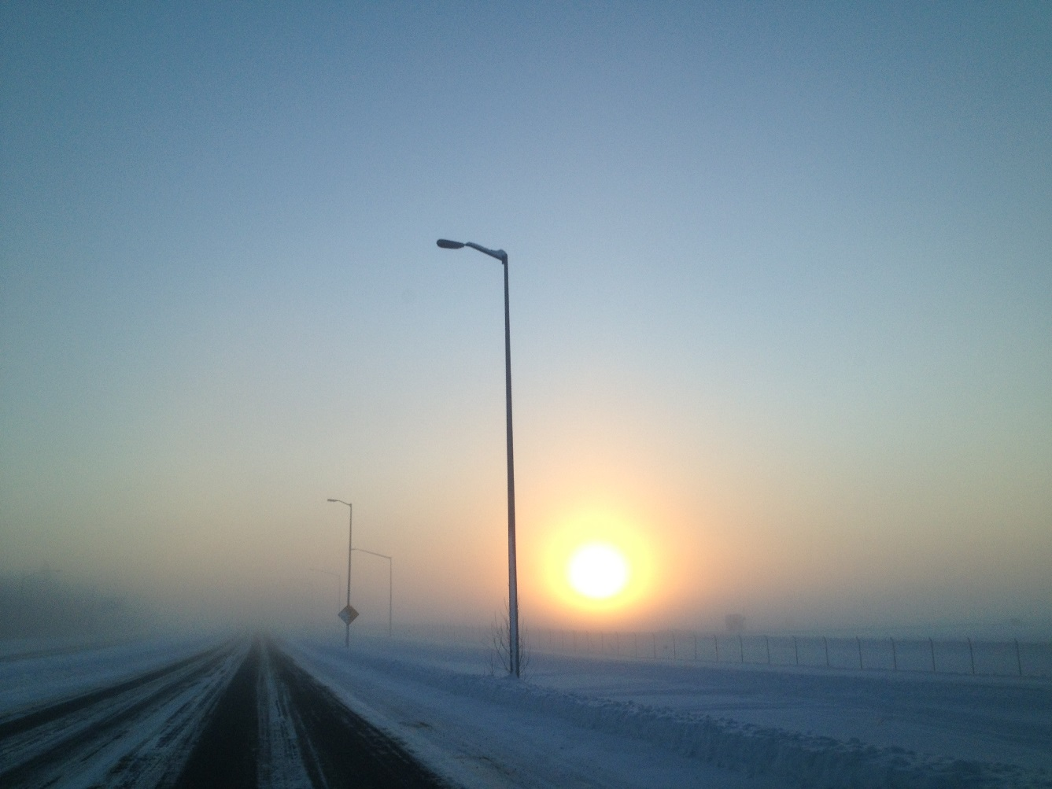
Environmental
Snow
Ice Fog
Darkness

Slide 19
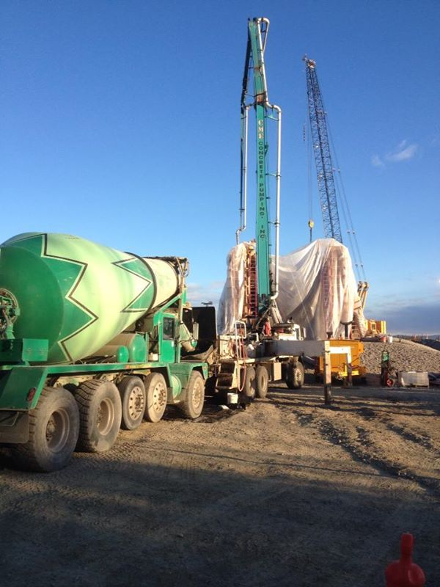
…and it ended on a beautiful autumn day
Oct. 25, 2013

Slide 20
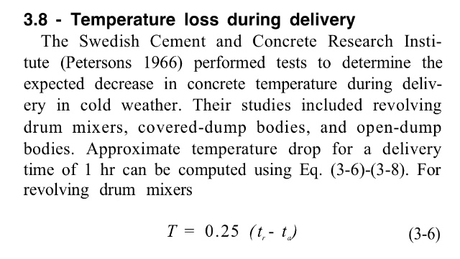

Slide 21
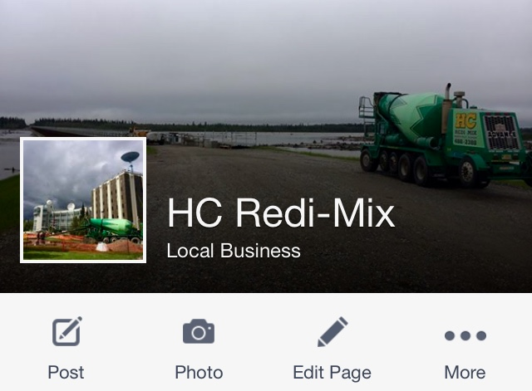

Slide 22
Client Perspective
Notes:
At this point I will turn the talk over to Sim, who will discuss the client’s point of view.

Slide 23
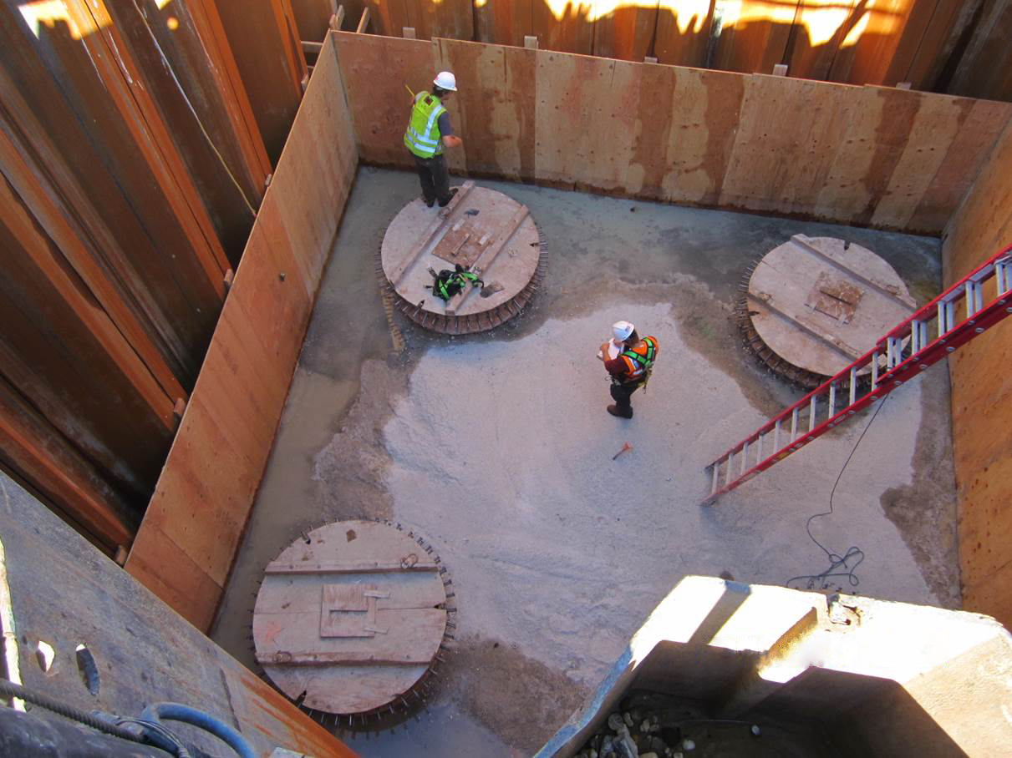
Notes:
Inspections before the pours:
Just like any concrete pour,
Check the forms
Rebar Inspection
Managing the water

Slide 24
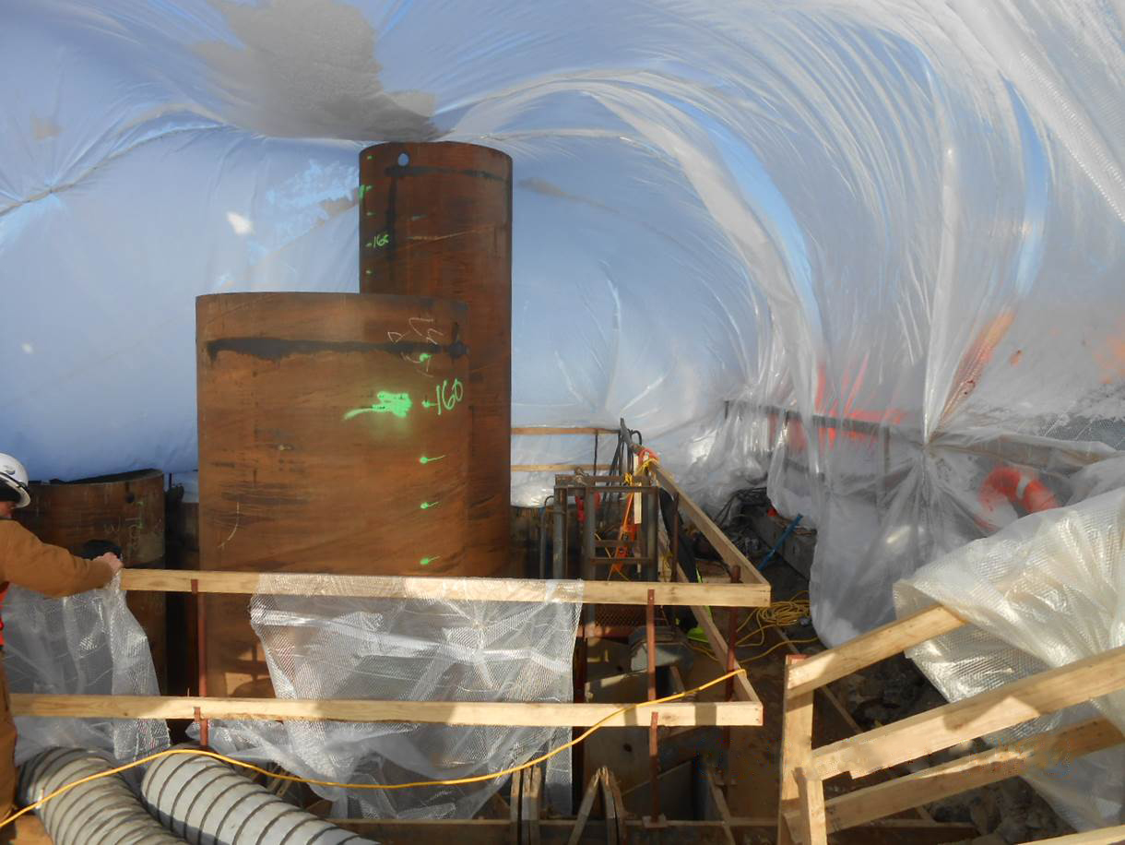
Heat, Heat, Heat and more Heat
Notes:
Maintaining heat, before, during and after pour
What was the critical times: from pre-batch to the forms.

Slide 25
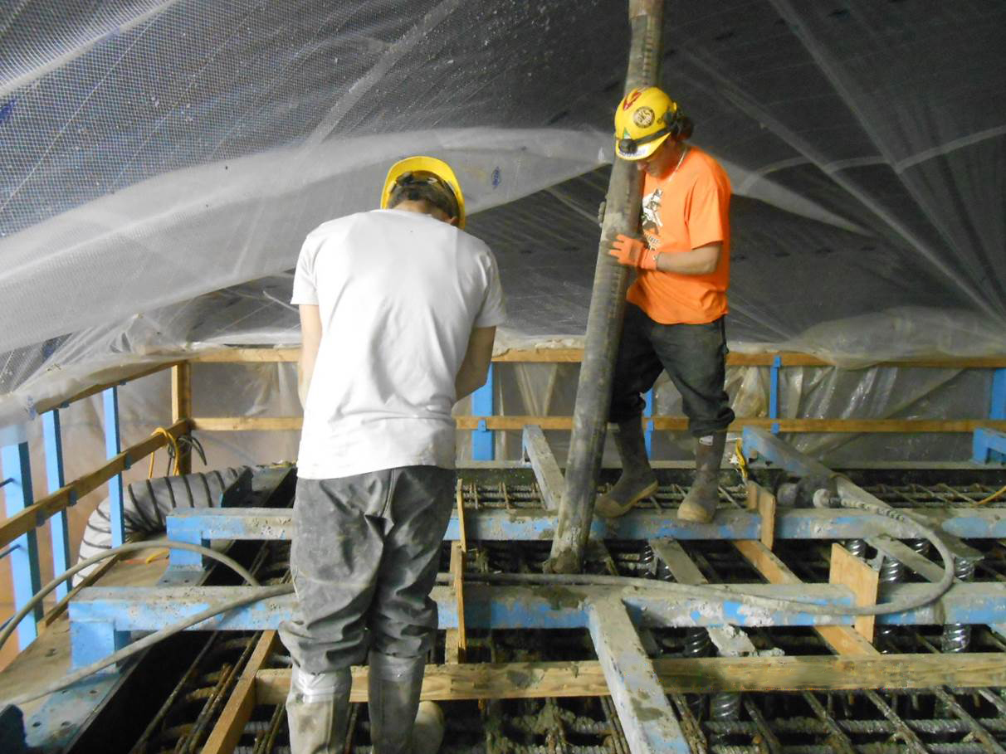
12/10/2012
Notes:
The forms were at 50 degrees plus prior to the pour,
Heat was on usually on from footing pour onwards, particularly if there was a leaky cofferdam. We couldn’t afford any water freezing.
Mid-December and this crew is working in tee shirts
After the pour, made sure tent was properly secured and temps were monitored.

Slide 26
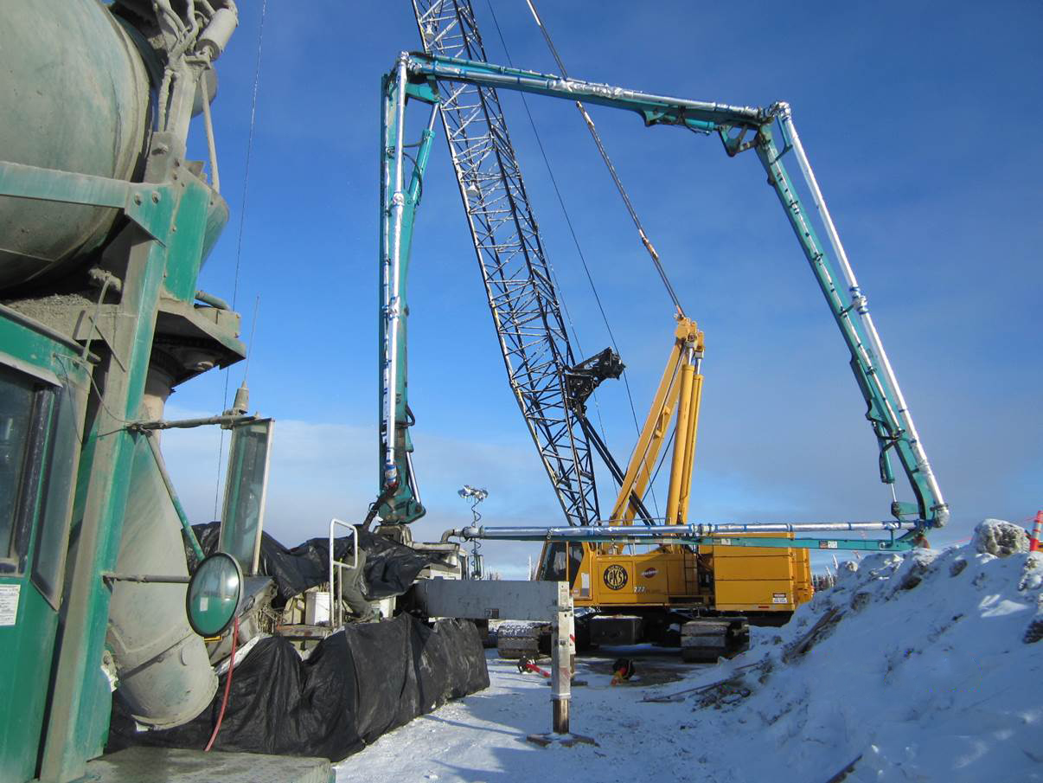
Notes:
The critical time was transit; batch plant to the pump truck

Slide 27
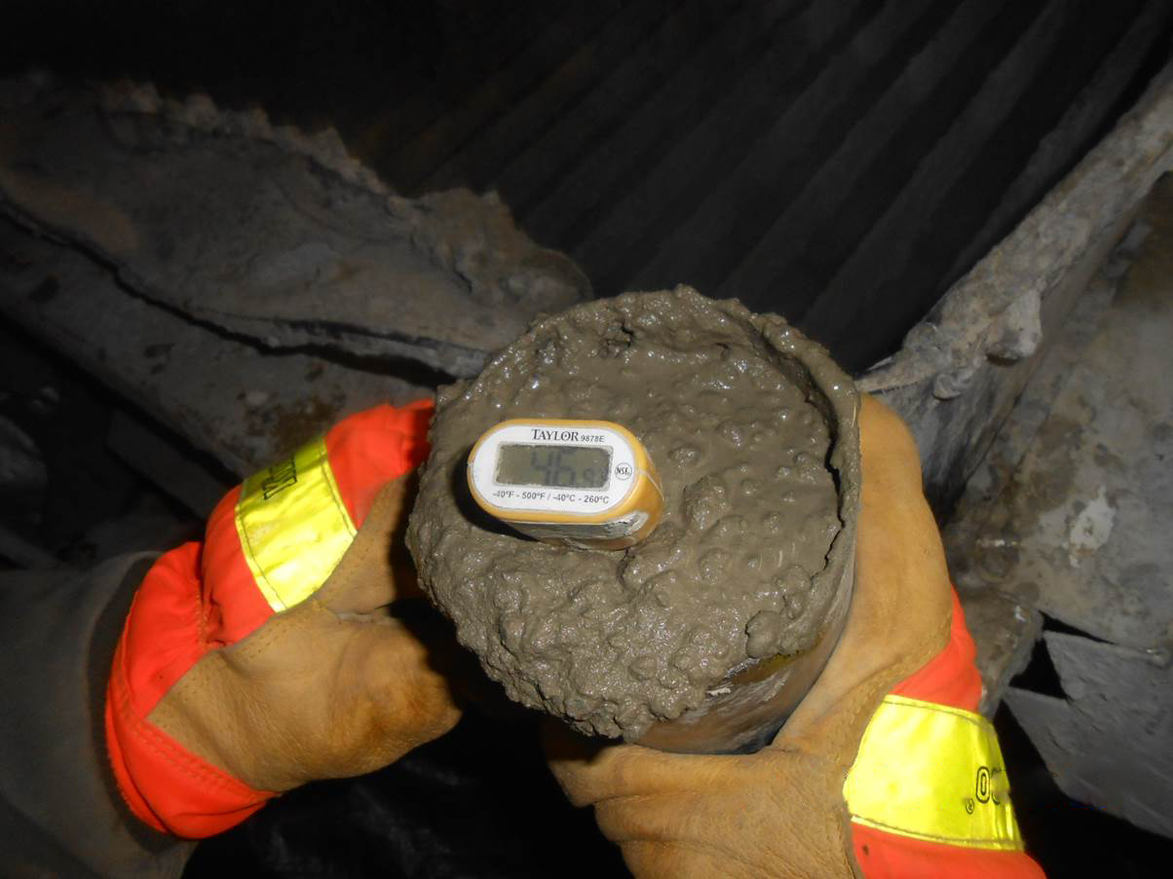
Notes:
Review of ACI (XXX) temperature specifications
After much discussion, lowered the acceptance specifications from 50 degrees to 40 degrees.
We took temps on every load of concrete.

Slide 28
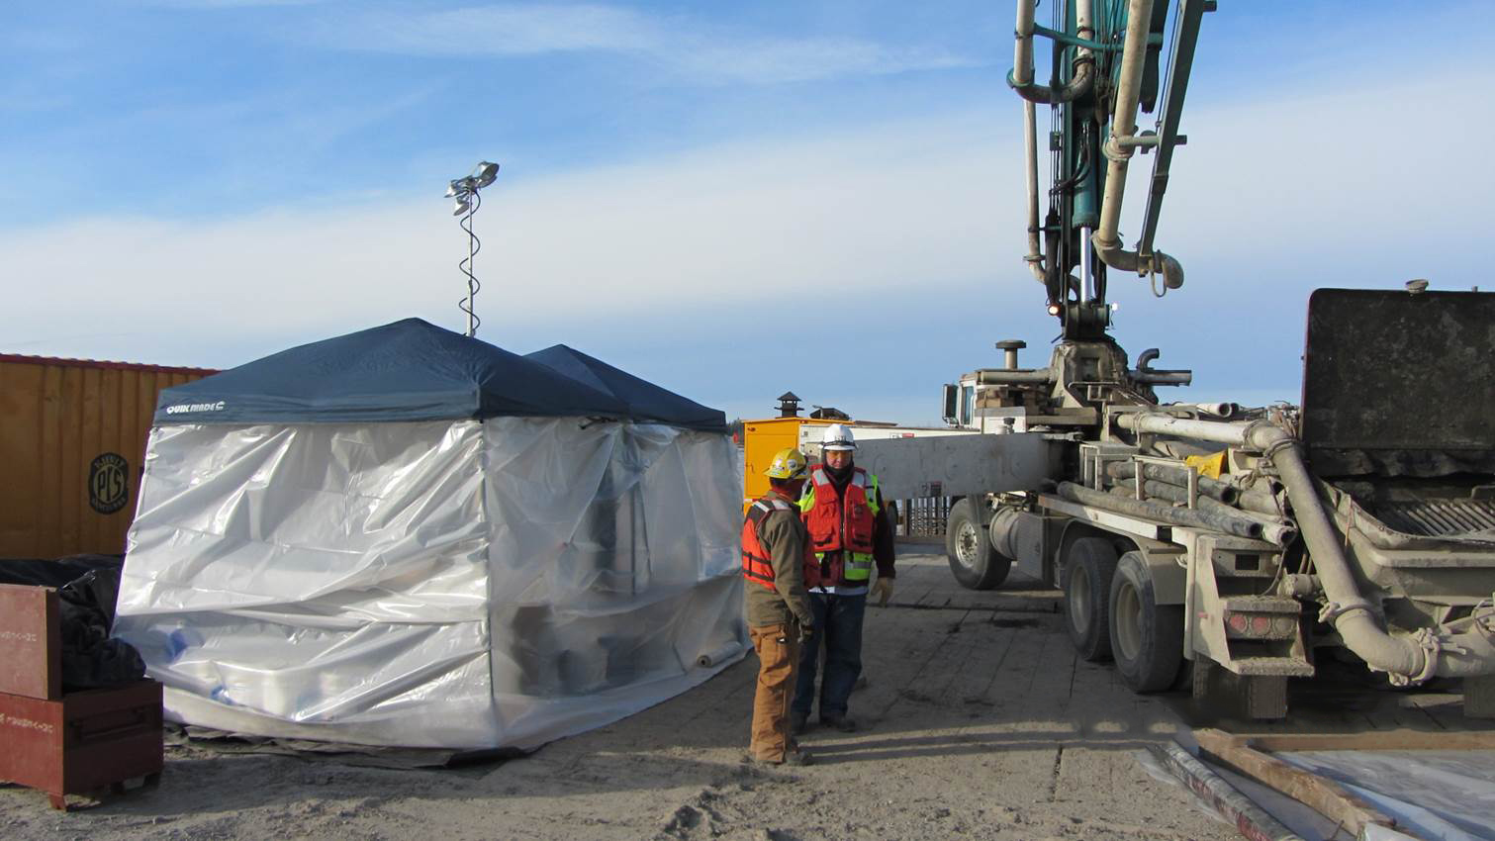
Notes:
This project received considerable funds from the State of Alaska
We used AKDOT&PF Sampling and Test procedures
Photo of our testing hut, the skirt around the pump truck isn’t set up yet

Slide 29
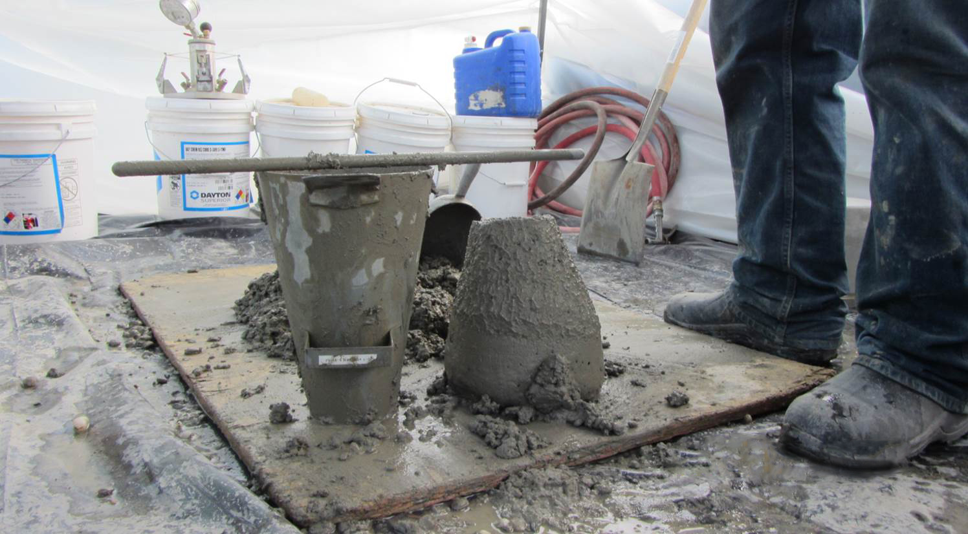
Notes:
Tested for:
Temperature
Time
Slump,
And ………………….next slide

Slide 30
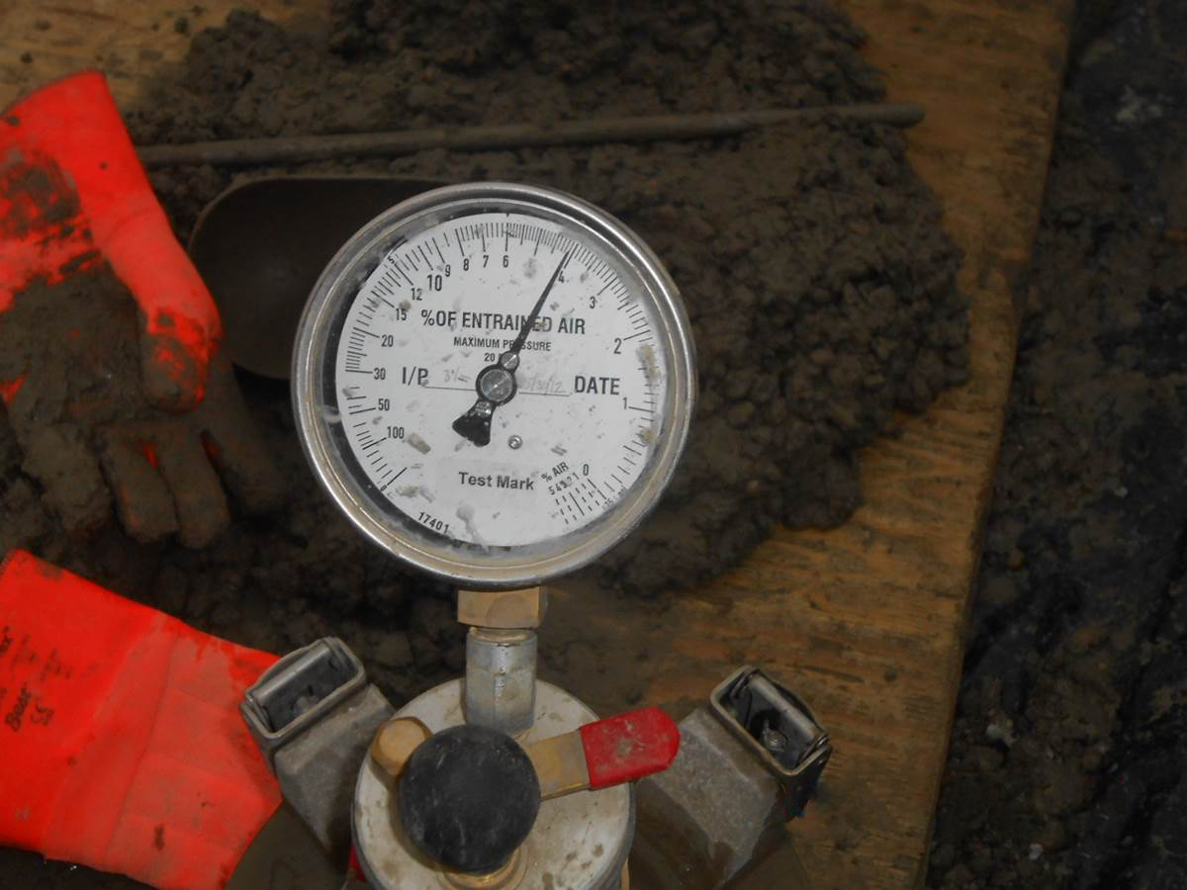
Notes:
Air entrainment
Unit weights
Cast specimens at 50 yard intervals

Slide 31
Protection of Concrete

Slide 32
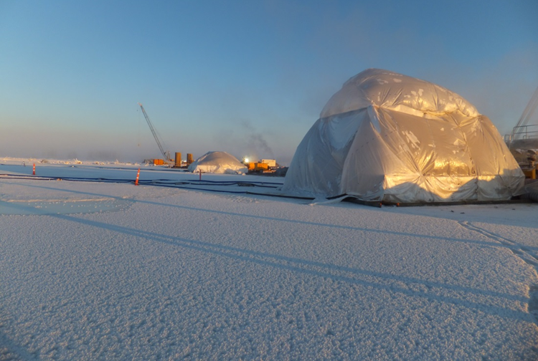
Specifications Required
5 days at 50 degrees
3 days at 70 degrees
Required 1or 2 Heaters
ESI or Allmand
(750k to 1000k btu)
Maintenance Personnel 24-7
4-6 GPH per Heater per hour
Notes:
Our specifications required that we protect the concrete and maintain 50 degrees for 5 day or 70 degrees for 3 days after the placement.
To do this we replaced that tenting that had been used through the pour process. We then heated with 2 maxi heaters that were at least 750k btu. These were not a cheap option as each heater burned 4-6 gallons of diesel an hour. We had crews monitoring the heaters and the temperatures inside the enclosures 24 – 7.

Slide 33
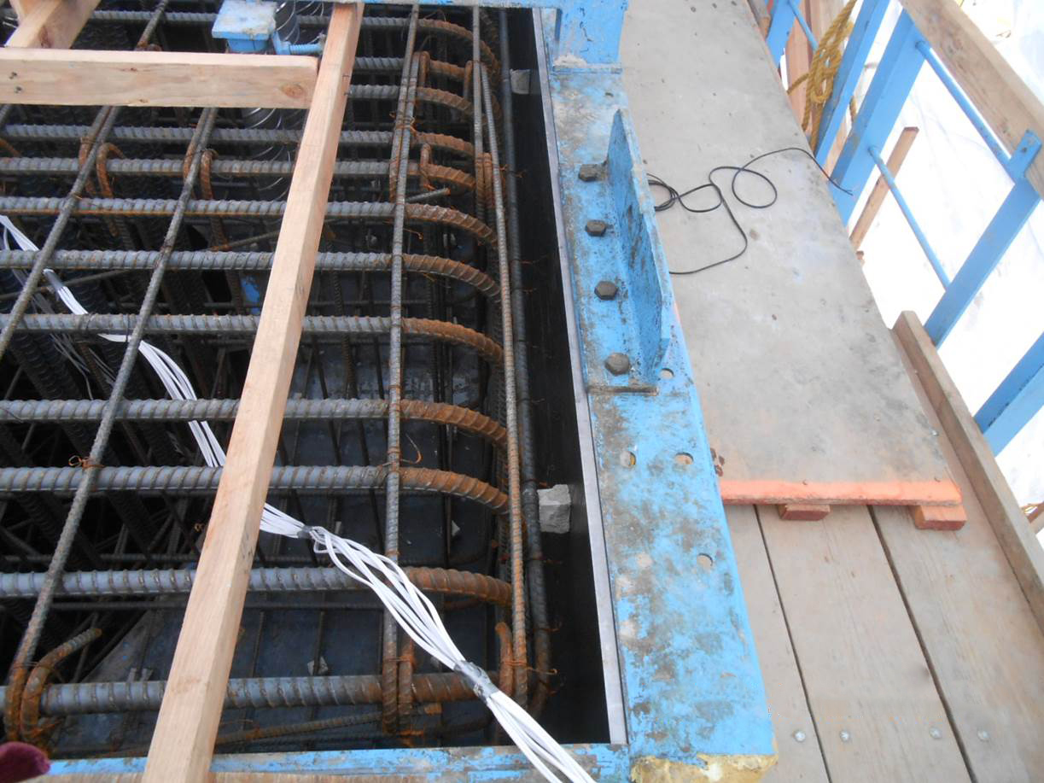
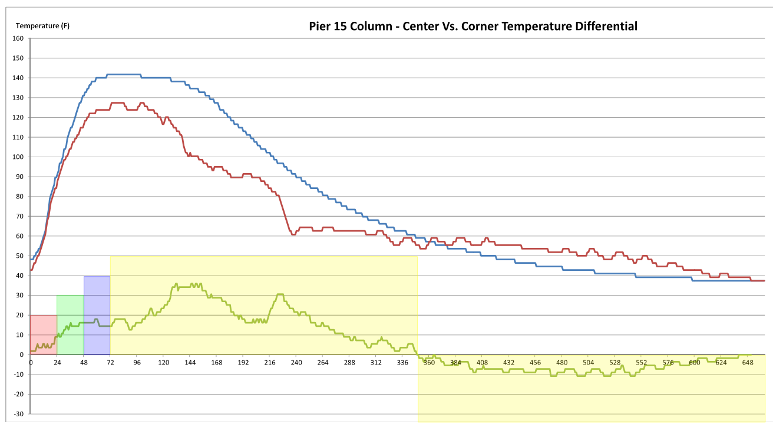
Notes:
As an added source of data we placed Thermal Coupler / data recorders in the concrete. (CLICK)
You can see the leads here (CLICK)
This data was used to make that there weren’t any major issues with the heating. (CLICK)
You can this sudden steep drop in the concrete temperature. This is when had to uncover for backfill. (CLICK)
This drop is about 9 days pour. (CLICK)

Slide 34
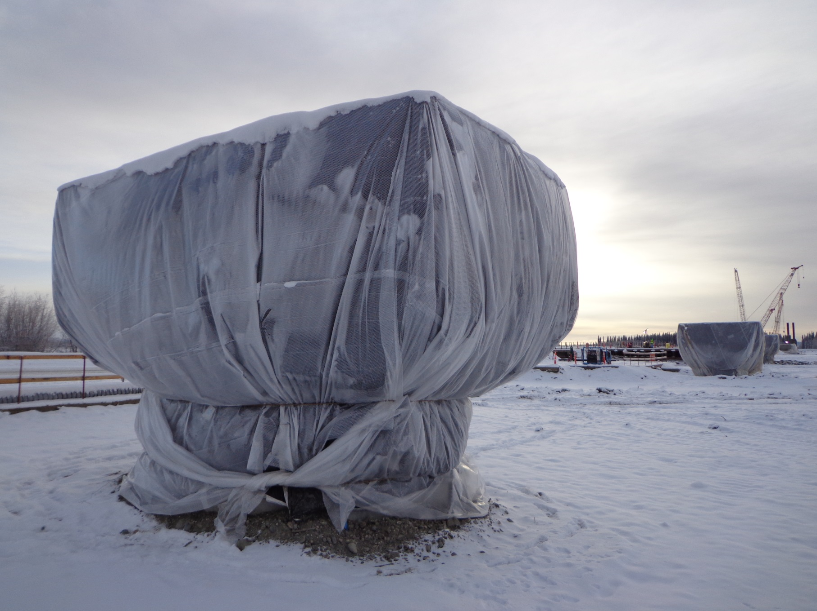
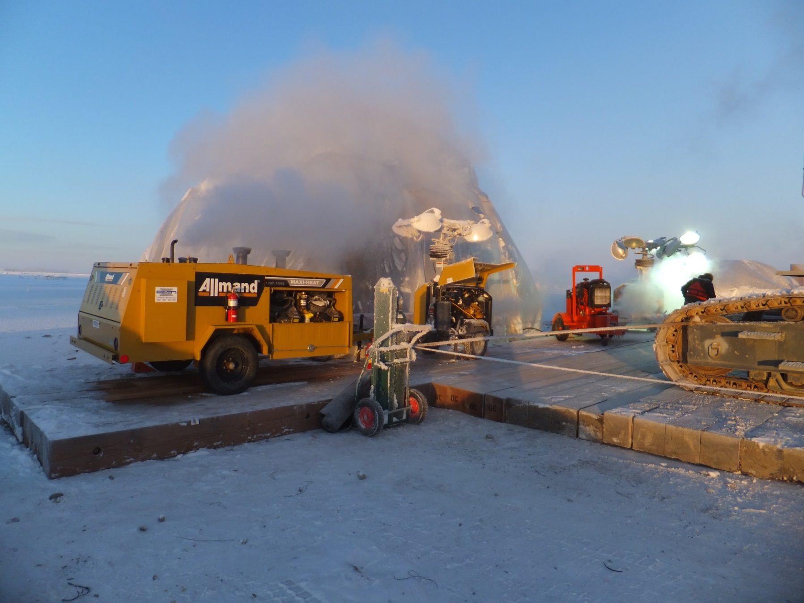
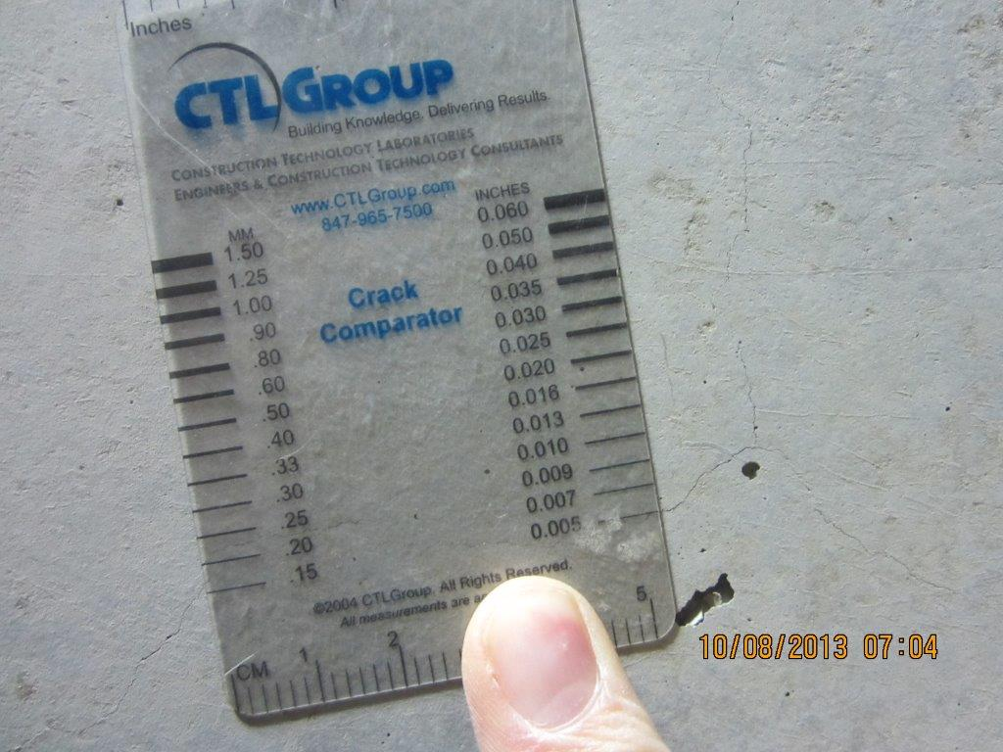
Notes:
We left heat on until we were ready to backfill, as you saw in the previous slide this could be several additional days of heating until mother nature and resources lined up to be able to strip and backfill as a continuous operation. (CLICK)
Once the forms were stripped we immediately performed a thorough inspection. (CLICK)
As soon as the inspection was complete we immediately backfilled, even if it had to be completed on night shift. (CLICK)
Finally we wrapped the columns in heat blankets and visqueen and left it there for 60 days. Although it was not required, we all felt that this step would keep the concrete from being shocked by the vast heat differential. (CLICK)

Slide 35
Conclusion
Notes:
To sum it up, we did not do anything that was too extreme or earth shattering to make our winter concrete operations a success.
We leveraged the knowledge and experience of our entire team to develop a solid plan. Once everyone had ownership in the plan, they took pride in making sure the we executed the plan nearly flawlessly. When issues were encountered we circled the wagons, jointly solved the problems, then moved on.

