Slide 1
Southcoast Region Outlook
Presentation DBE Conference
March 15, 2022

Slide 2
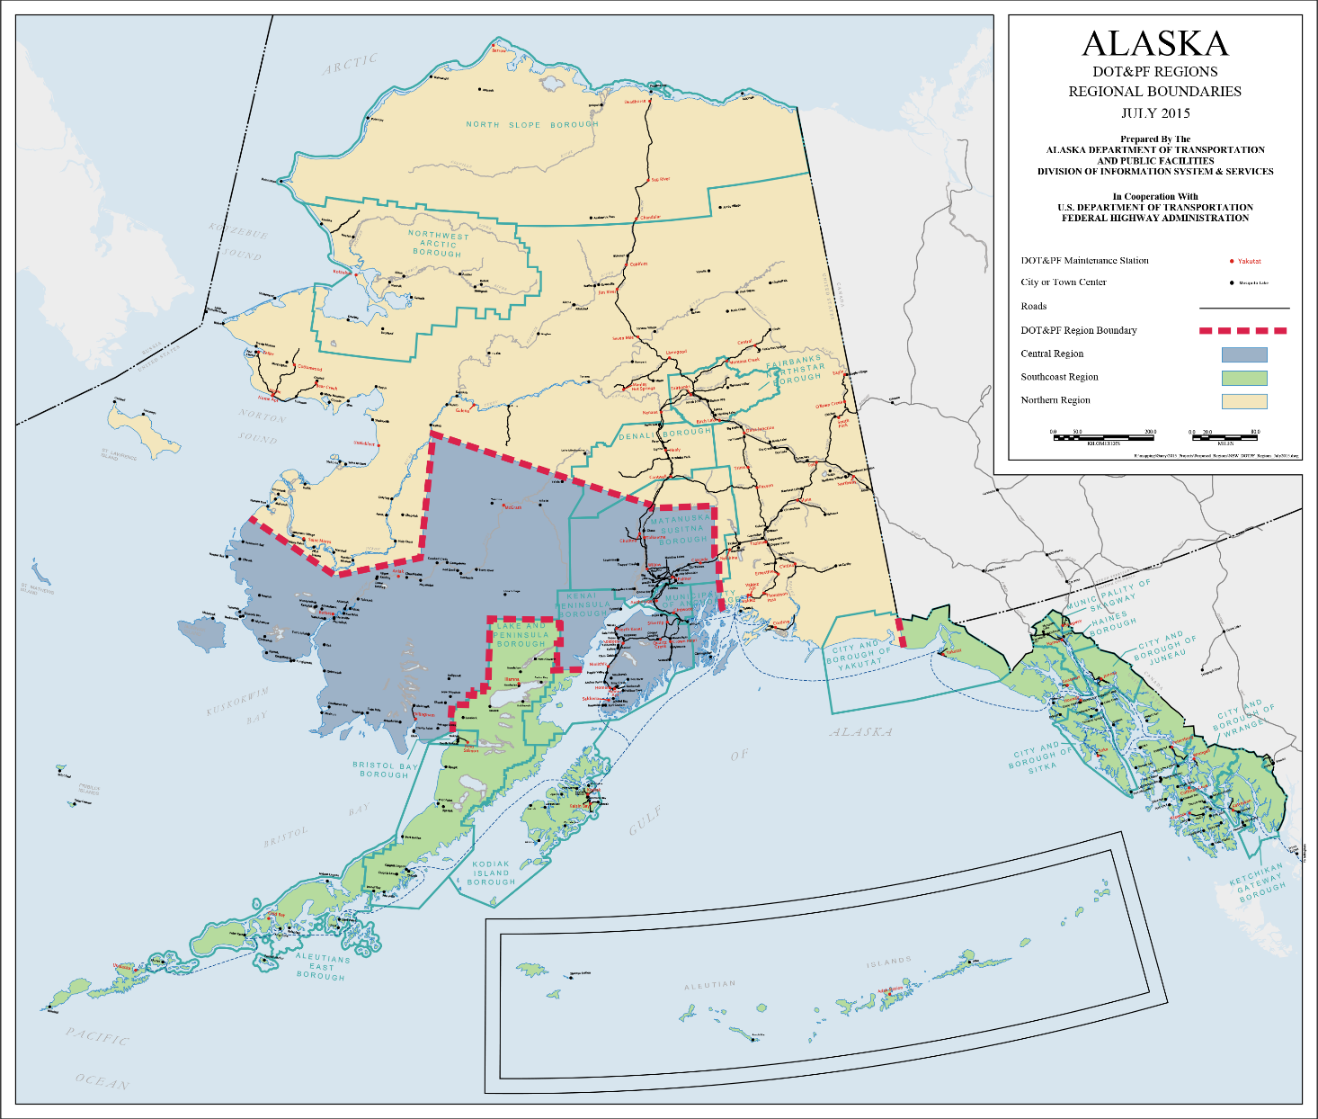
SOUTHCOAST REGION OVERVIEW
SOUTHCOAST REGION STATS
Road Lane Miles | 1,859.5
Maint. Stations | 20
Maintained Airports | 45
Seaplane Bases | 17
Bridges | 286
Harbors | 16
Communities | 86
Boroughs | 12
City Governments | 51
Tribes | 60

Slide 3

SOUTHCOAST REGION CAPITAL PROGRAM
2022 SOUTHCOAST REGION CONSTRUCTION
Projected Contract Values | $100 to 110 million
Total Number of Projects | 27 plus 9 FEMA projects
State Highways Match | 9.03%
State Airports Match | 5.0%-6.25%
Communities with Active Projects | 12
Highway Projects | 20 plus 9 FEMA projects
Airport Projects | 7

Slide 4
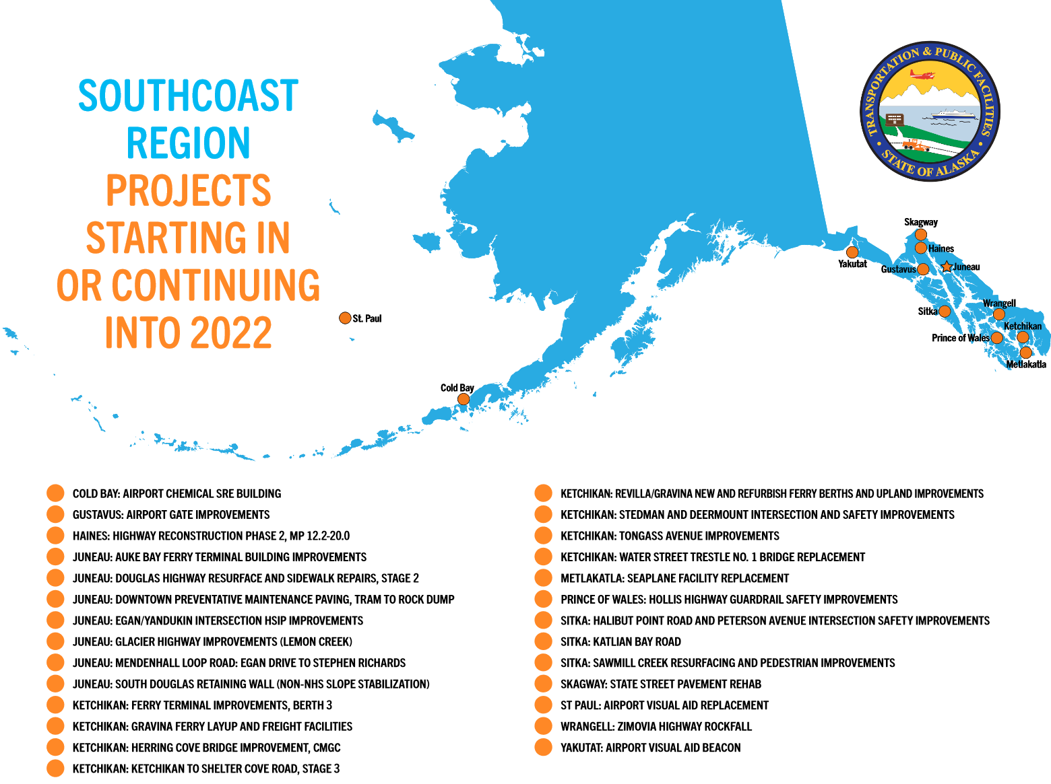

Slide 5
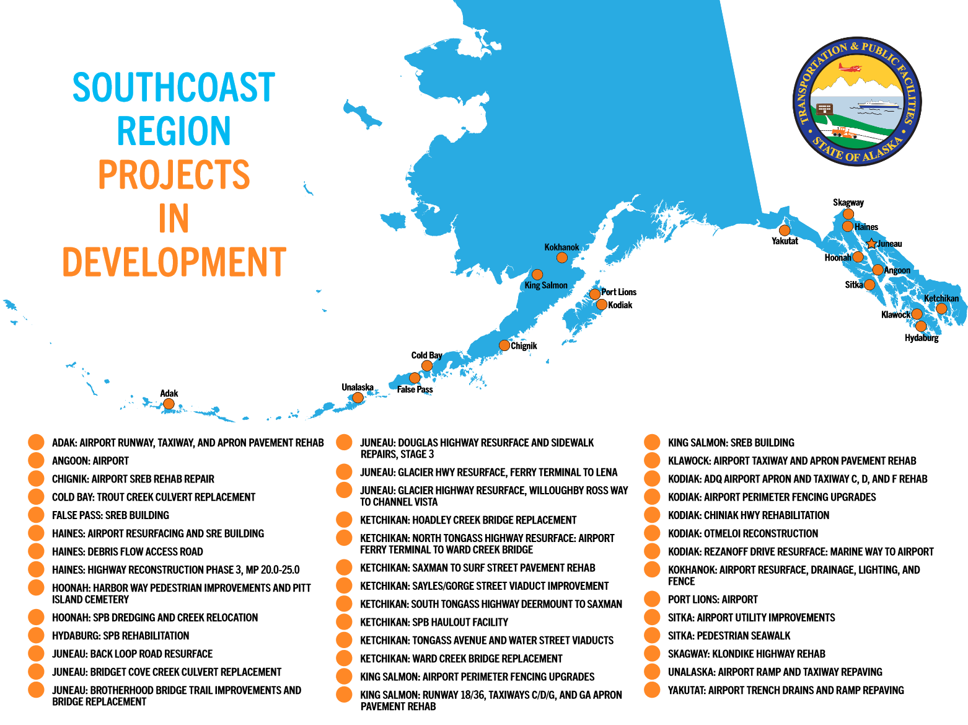

Slide 6
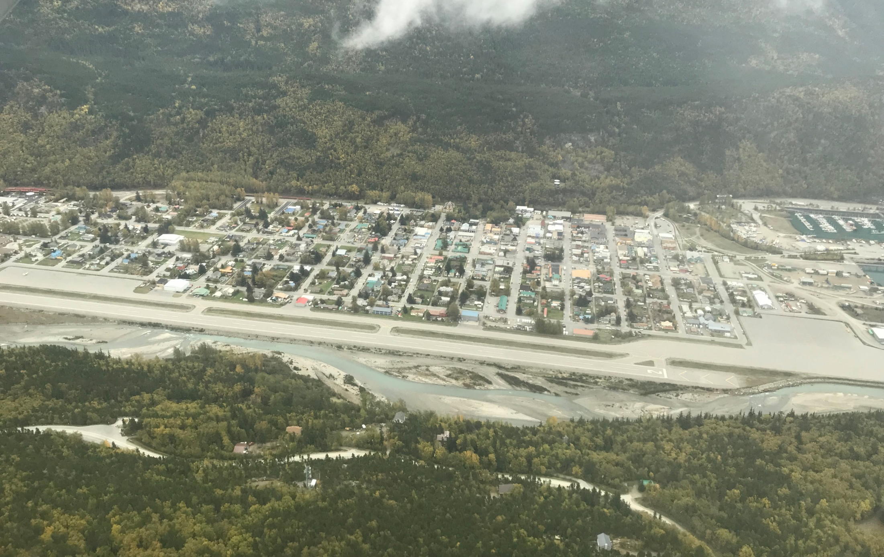

Tentative Advertise Schedule
Projects upcoming:
KTN FERRY TERMINAL IMPROVEMENTS - $2.5-5M
HSIP KTN STEDMAN & DEERMOUNT ST INTERSECTION SAFETY IMP - $0.5-1M
JNU THANE ROAD 189449 - DEC 20 SE PR - $0.5-1M
SR REGIONWIDE NHS SLOPE STABILIZATION - $0.5-1M
JNU DOUGLAS HIGHWAY SLOPE STABILIZATION - $1-2.5M
JNU DOUGLAS HWY STAGE 2 CONSTRUCTION- $5-10M
JNU FRANKLIN AND THANE RESURFACING: TRAM PARKING LOT TO MT. ROBERTS ST - $1-2.5M
Notes:
Tentative Advertise list:
KTN FERRY TERMINAL IMPROVEMENTS – 2.5 to 5.0 M
This project encompasses the replacement of an existing vessel berthing and turning dolphins structure, a new turning dolphin, refurbishment of fendering and platform components, a new pedestrian cover structure, and the placement of cathodic protection anodes.
HSIP KTN STEDMAN & DEERMOUNT ST INTERSECTION SAFETY IMP – $0.5 to $1 M
Provide additional illumination at the Stedman/Deermount intersection to achieve a level of luminance that meets current DOT&PF standards. Construct a concrete sidewalk bulbout on the Stedman side of the marked crosswalk. The bulbout will extend from the existing sidewalk to the edge of the traveled way.
JNU THANE ROAD 189449 - DEC 20 SE PR–$0.5 to $1 M
This project is a Permanent Repair (PR) due to flooding that occurred during the December, 2020 storm event in Southcoast Region of Alaska. Repairs may include, but are not limited to, asphalt, embankment, geotextile, riprap, and drainage. This project repairs a site on Thane Road at MPt 4.4. This is a FEMA funded project which will be reimbursed thru RSA with DMVA
SR REGIONWIDE NHS SLOPE STABILIZATION-$0.5 to $1M
This project will construct a maintenance access to a location on the Haines mile 19 debris flow. Construction activities include clearing, grubbing, excavation, grading, signage, fabrication of a vehicle access gate, and implementation of BMPs.
JNU DOUGLAS HIGHWAY SLOPE STABILIZATION-$1-2.5M
Repair a recent slope failure adjacent to a soldier pile and lagging retaining wall along the Juneau-Douglas Highway, in Douglas, Alaska. The purpose of the project is to protect the highway slope from failure due to down slope landslide activity out of the ROW by constructing a soldier pile wall.
JNU DOUGLAS HWY STAGE 2 CONSTRUCTION- $5-10M
Work required for this project includes reconstructing and resurfacing Douglas Highway from about 700 feet south of Cordova Street to F Street. Subcontractor type work includes: Removal and installation of concrete gutter and curb & gutters • Removal and installation of concrete sidewalks • Reconstruction of existing accessible sidewalk ramps • Replacement and lining of existing culverts and storm drains • New pavement markings • Replacement of existing guardrail and bridge transition rail • Repairs to existing Lawson Creek Bridge joints
JNU FRANKLIN AND THANE RESURFACING: TRAM PARKING LOT TO MT. ROBERTS ST - $1-2.5M
Resurface Franklin Street from the Tram parking lot to the intersection of Thane Road and Mt. Roberts Street. Subcontractor type work includes: striping, signs, and concrete ADA improvements

Slide 7
Tentative Advertise Schedule
Projects upcoming:
SR DM AIRPOR GATE/FENCE REPAIRS/REPLACEMENT- < $0.2M
HNH SEAPLANE FACILITY DREDGING AND CREEK RELOCATION - $0.5-1M
SIT HALIBUT POINT RD & PETERSON AVE INTERSECTION SAFETY IMPR- $0.5-1M
JNU EGAN YANDUKIN INTERSECTION IMPROVEMENTS HSIP- $1-2.5M
KING SALMON AIRPORT PERIMETER FENCING UPGRADES- $1-2.5M
KTN AIRPORT SEAPLANE RAMP AND HAUL OUT REFURBISHMENT - $1-2.5M
Notes:
Tentative Advertise list:
SR DM AIRPOR GATE/FENCE REPAIRS/REPLACEMENT- < $0.2M
Replace an existing electric cantilever gate with a new 24’ electric vertical pivot gate on a new concrete foundation at the Gustavus Airport.
HNH SEAPLANE FACILITY DREDGING AND CREEK RELOCATION - $0.5-1M
Relocation of an existing stream bed and conduct dredging under the seaplane mooring float to restore sufficient water depths and/or relocation of the seaplane float structure to deeper water at the same location.
SIT HALIBUT POINT RD & PETERSON AVE INTERSECTION SAFETY IMPR- $0.5-1M
Provide additional illumination at the Halibut Point Road/Peterson Avenue Intersection to achieve a level of luminance that meets current DOT&PF standards. Modify adjacent roadway lighting as needed to maintain satisfactory continuous illumination. Establish a pass-through crossing to facilitate less challenging pedestrian movements. Improve intersection sight distance by removing utility equipment located in the southeast quadrant of the intersection, acquiring property to remove parking spaces that, when occupied, create sight line obstructions, and modifying access to an apartment building adjacent to the intersection (shorten curb cut). Replace existing S1-1 School signs with W11-2 advance pedestrian warning signs.
JNU EGAN YANDUKIN INTERSECTION IMPROVEMENTS HSIP- $1-2.5M
Set seasonal speed limit reduction on Egan in the vicinity of the Egan Yandukin intersection. Improve delineation for both left turns on Egan to improve line of sight and reduce travel distance to clear opposing traffic. Improve delineation for the northbound right turn movement from Egan to make it easier for southbound left turn drivers to determine if opposing traffic is executing the right turn or continuing through the intersection.
KING SALMON AIRPORT PERIMETER FENCING UPGRADES- $1-2.5M
Replace/upgrade access controls/gates to meet 49 CFR 1542 requirements. Replace existing fencing as needed
KTN AIRPORT SEAPLANE RAMP AND HAUL OUT REFURBISHMENT - $1-2.5M
Refurbish and/or replace existing seaplane float and haul-out ramp facility at the Ketchikan Airport.

Slide 8
Skagway State Street
Project estimate:
Between $10 and $20 million
Work begins in 2022 and the project is scheduled to complete in 2024.
The project will resurface the roadway, replace drainage, replace curb and gutter, and upgrade curb ramps to meet ADA standards.
Notes:
SGY STATE STREET PAVEMENT REHABILITATION
Subcontractor type work includes: replace curb and gutter in select areas, upgrade curb ramps and vehicular curb cuts to meet ADA standards, stripping, and replace all signs within the project limits.

Slide 9
Other Notes of Interest
New Regional Office Engineer – Paige Drayton- DOT.SR.CON.RCCL@alaska.gov
Adding a sub-contractor after letting
AASHTOWare Certified Payroll – Become a user
CUF Reviews
Expect more plans sets attached to Southcoast Projects on the Tentative Advertise list.
Have a question, Give us a call.
Kake Access Road construction.
Notes:
New Regional Office Engineer – Paige Drayton- DOT.SR.CON.RCCL@alaska.gov
Adding a sub-contractor after letting requires approval in section 103 and a 5 day notice. We will work swiftly to process these request but it will be key to use the e-mail above.
AASHTOWare Certified Payroll – Become a user- We have moved to AASHTOWare so it is critical you become a user for Certified payrole.
CUF Reviews – We care about protecting the rights of DBE’s and in doing so we preform CUF reviews to ensure your rights are guarded. I ask that you please let your workers know they may be asked questions as apart of this process on the job with the intent to look after the DBEs.
Expect more plans sets attached to Southcoast Projects on the Tentative Advertise list. – This is a recent change for us but should be going into effect as reviews come on line over the coming months. Really want you to understand the nature of upcoming work.
Have a question, Give us a call. - There are people on the line designers who can answer questions and also like to learn from you too. Please take us up on this offer if you see something in our plan sets to have a converstation.

Slide 10
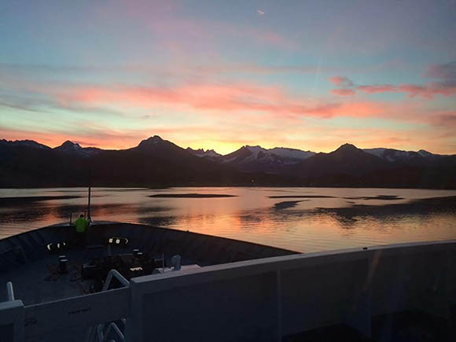
THANK YOU!

